Slide 1
STATISTICAL ANALYTICAL SYSTEM
(SAS)
Born in 1960

Slide 2
Data Science Marketplace
Proprietary Tools
SAS
SPSS
Stata
Matlab
Open Source or Freemium
Python, R
KNIME

Slide 3
Data Science Marketplace
Low Code/ No-Code
SAS Enterprise Miner , SAS Visual Analytics etc.
KNIME
Altair
Dataiku
Coding Involved
Python, R
SAS (Base and Advanced)

Slide 4
SAS Training
Base SAS
SAS Language Concepts
SAS Procedures
Exercises
SAS Macros
Macro Language concepts
Exercises

Slide 5
What is SAS ?
SAS is a set of solutions for enterprise- wide business
users for performing:
Data entry, Retrieval, and Management
Report writing and Graphics
Statistical and Mathematical Analysis
Business planning, Forecasting, and Decision support
Operations research and Project Management
Quality Improvement
Applications Development

Slide 6
The core of the SAS System is base SAS software, which consists of
SAS Language
SAS Procedures
SAS Macros
Data Step Debugger
ODS
Windowing Environment

Slide 7
SAS Language Concepts
The basic components of SAS language are :
SAS Files
Data Step
Procedure Step
SAS informats
SAS formats
Variables
Functions
Statements
Reading of Raw Data
Miscellaneous (SAS Programs,Outputs,Log And Errors)

Slide 8
We will study SAS in three parts
Bringing data into the SAS System and understanding nuances of data types and debugging unexpected outcomes
Data Manipulation using Data Step and Proc SQL
Creating different reports in SAS and exporting data as per requirements
In the process , a crucial skill that we are going to acquire and master is debugging a SAS code

Slide 9
First things First - SAS Studio
What is SAS Studio ?
SAS Studio is a web-based interface for writing, running, and managing SAS programs without needing local installation,
It offers a user-friendly environment for data manipulation, analysis, and visualization.
SAS provides a free trial of SAS Studio on Azure through its SAS Viya for Learners and Developers program, allowing users to explore SAS capabilities directly on Azure's cloud infrastructure for a limited period.

Slide 10
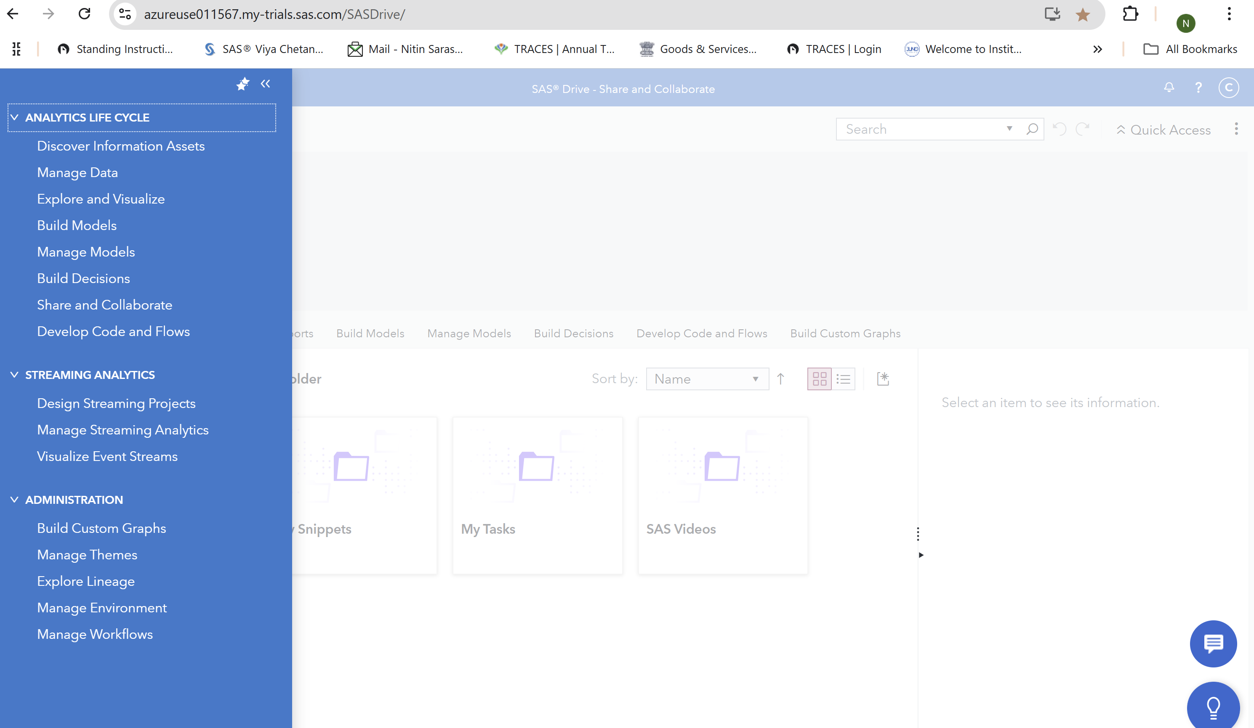
First things First - SAS Studio

Slide 11
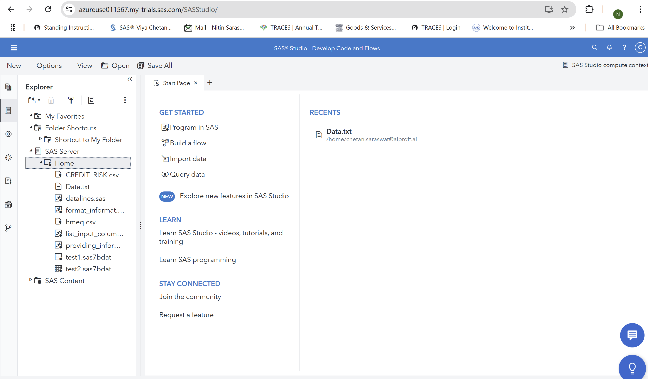
First things First - SAS Studio

Slide 12
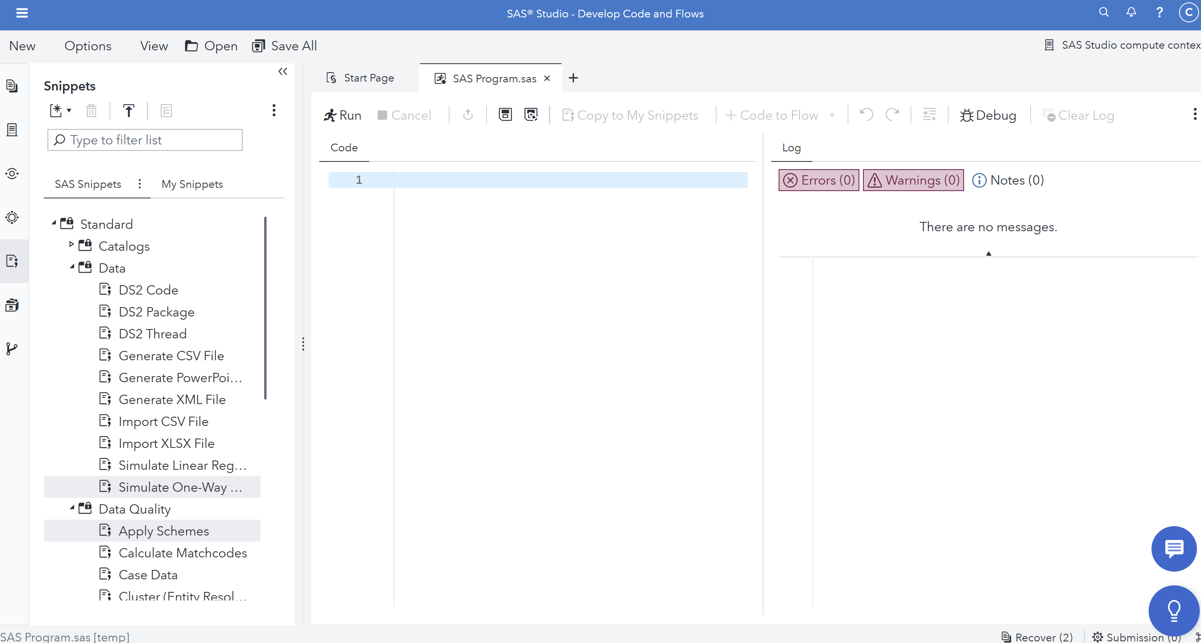
First things First - SAS Studio

Slide 13
BRINGING DATA INTO SAS

Slide 14
SAS Basic Concepts
SAS System understand only two kinds of data –
CHARACTER
NUMERIC
So the question is how are other types of values like dates , formatted values interpreted and stored in SAS
And that’s what we are going to learn today

Slide 15
SAS Basic Concepts
SAS Programs contains tow basic steps viz. “DATA” Step and “PROC” step.
A SAS program may contain a DATA step, a PROC STEP or any combination of DATA and PROC step
Data Mylib.Test2;
Set Mylib.Test1;
Run;
Proc print Data = Mylib.Test2;
Run;

Slide 16
SAS Basic Concepts
SAS Statements – Usually begins with a keyword, always ends with a semicolon and are free format.
The example below contains 5 SAS statements.
Data Mylib.Test2;
Set Mylib.Test1;
Run;
Proc print Data = Mylib.Test2;
Run;
The statements are: Data Statement, Set Statement, Run statement, Proc Print Statement and another Run statement.

Slide 17
SAS Basic Concepts
What happens when a SAS program is submitted?
SAS software reads the statements and checks them for errors
When it encounters a DATA, PROC, or RUN statement, SAS software stops reading statements and executes the current step in the program.
Each time a step is executed, SAS software generates a log of the processing activities and the results of the processing. The SAS log collects messages about the processing of SAS programs and any errors that may occur.
Separate sets of messages for each step in the program are produced.

Slide 18
SAS Basic Concepts
The following program is submitted:
Data Example2;
Set Example1;
Run;
Proc Print Data = Example2;
run;
The submission of the program will cause the DATA step to be executed first followed by the PROC step. The log will contain separate sets of messages for each step.

Slide 19
SAS Basic Concepts
Following log message is generated:
10 Data Example2;
11 set Example1;
12 Run;
NOTE: The data set WORK.EXAMPLE2 has 2560 observations and 23 variables.
NOTE: The DATA statement used 0.01 CPU seconds.
13 Proc Sort Data = Example2 Out = Example3 ;
14 By Pat Vis Unvis;
15 Where Pat < 200;
16 run;
NOTE: WER750I End PROC SYNCSORT. R2.2E*
NOTE: The data set WORK.EXAMPLE3 has 14 observations and 23 variables.
NOTE: The PROCEDURE SORT used 0.03 CPU seconds.

Slide 20
SAS Basic Concepts
The result of a DATA step or a PROC step may vary from producing a dataset, report, opening a interactive window etc.
Consider the example below:
Data Mylib.Test2;
Set Mylib.Test1;
Run;
Proc print Data = Mylib.Test2;
Run;
The SAS files Mylib.Test2 & Mylib.Test1 have two level names with a period in between. To reference a SAS file a two level name is used as follows:
Libref.Filename

Slide 21
SAS Basic Concepts
In the two-level name Libref is the name of the SAS library that contains the file. Filename is the name of the file itself.
In the previous example, Mylib is the name of the SAS library in which the SAS dataset Test1 resides.
In a two-level reference a Libref other than WORK indicates that the dataset being referenced is stored permanently. To specify a temporary SAS file the Libref WORK is used.
Thus, a two-level name Mylib.Test1 is referencing a dataset ‘Test1’ stored permanently in SAS library having library reference ‘Mylib’. Whereas, a two-level name Work.Test2 is referencing a a dataset ‘Test2’ in temporary SAS library (WORK)

Slide 22
SAS Basic Concepts
Alternatively, a temporary SAS dataset can be referenced via one-level name only. This one level name is the filename itself and it assumes the default Libref of WORK.
That is, the one level name of ‘Test1’ references the SAS dataset ‘Test1’ stored in temporary WORK library.

Slide 23
SAS Basic Concepts
What is a SAS dataset?
SAS dataset is a SAS file consisting of two parts: Descriptor portion and a Data portion.
Data Portion
It is a collection of data values arranged in rectangular fashion.
Descriptor Portion
Data Portion
ID | Name | Sex | Age
101 | Joe | M | 26
123 | Beth | F | .
131 | Nancy |  | 32
121 | Dave | M | 43
135 | Betty | F | 18
Data values

Slide 24
SAS Basic Concepts
Rows in a dataset are addressed as Observations while Columns in a dataset are addressed as Variables.
Observation corresponds to records while Variable corresponds to fields.
The example below contains 5 observations and 4 variables.
Variable
ID | Name | Sex | Age
101 | Joe | M | 26
123 | Beth | F | .
131 | Nancy |  | 32
121 | Dave | M | 43
135 | Betty | F | 18
Observation

Slide 25
SAS Basic Concepts
The rectangular arrangement of rows and columns in a SAS data set implies that every variable must exist for each observation. If a data value is unknown for a particular observation, a missing value is recorded in the SAS data set.
Missing values for Character variables is represented by a blank while a period is used to represent a missing value for numeric variable.
ID | Name | Sex | Age
101 | Joe | M | 26
123 | Beth | F | .
131 | Nancy |  | 32
121 | Dave | M | 43
135 | Betty | F | 18
Missing Values

Slide 26
SAS Basic Concepts
Descriptor Portion:
The descriptor portion of a dataset contains information about the dataset like: Name of dataset, date and time the dataset was created, number of Observations,number of variables.
A example of SAS descriptor portion is as follows:
Data Set Name: WORK.TEST1 Observations: 5
Member Type: DATA Variables: 4
Engine: BASE Indexes: 0
Created: 2:38 Tuesday, December 7, 2004 Observation Length: 32
Last Modified: 2:38 Tuesday, December 7, 2004 Compressed: NO
SAS data set names must be as per following rules:
should be 1 to 32 characters in length
should begin with a letter (A-Z, including mixed case characters) or an underscore (_)
continue with any combination of numbers, letters, or underscores.

Slide 27
SAS Basic Concepts
The descriptor portion also contains information about the Variable attributes for each variable in the dataset.
The attribute information includes the variable’s name, type, length, format, informat and label.
Variable Type Len Pos Format Label
-----------------------------------------------------------------------------------
DOB Num 8 8 YYMMDD10. Date of Birth
ID Num 8 0 Patient Id
NAME Char 8 16 Patient Name
SEX Char 8 24 Gender

Slide 28
SAS Basic Concepts
Variable Name- The variable names must be as per the following SAS naming conventions:
be 1 to 32 characters in length
begin with a letter (A-Z, including mixed case characters) or an underscore (_)
continue with any combination of numbers, letters, or underscores
Variable Type – A Variable’s type is either character or numeric.
character variables contain alphabetic characters, numeric digits 0 through 9, and other special characters.
numeric variables are stored as floating point numbers including dates and times.

Slide 29
SAS Basic Concepts
Variable Length- It is the number of bytes used to store the variables values in a SAS dataset and depends on the variable type.
The length of a character variable can be up to 32K. The default length for character variables is 8 bytes.
The length of a numeric variable can be 2 to 8 bytes (regardless of how many digits they contain). The default length of numeric variables is 8 bytes. That is, numeric values are stored as floating point numbers in 8 bytes by default (regardless of how many digits they contain).
Variable Informats - An Informat is an instruction that SAS uses to read data values into a variable. Informat must be used to read standard/non-standard data (numeric data containing letters or special characters such as comma)

Slide 30
SAS Basic Concepts – Why do we need informat and format in SAS ?
$1,000,000 is a non-standard numeric data as it contains a dollar sign ($) and commas (,). In order to remove the dollar sign and commas before storing the numeric value 1000000 in a variable, read this value with a COMMA11. Informat.
Variable Formats - A Format is an instruction that SAS uses to write data values. Formats are used to control the written appearance of data values, or, in some cases, to group data values together for analysis. For example, the WORDS22. format, which converts numeric values to their equivalent in words, writes the numeric value 692 as six hundred ninety-two.
Variable Labels - refers to a descriptive label up to 256 characters long. A variable label, which can be printed by some SAS procedures, is useful in report writing. For example a variable ID can be assigned a more descriptive label of ‘Patient Id’

Slide 31
SAS Basic Concepts
Consider the following example:
Libname Mylib “/home/chetan.saraswat@aiproff.ai/”;
Filename Myfile “/home/chetan.saraswat@aiproff.ai/Data.txt’;
Data Mylib.Test1;
Infile Myfile;
Input Id 1-3 Name $ 5-9 Sex $ 11-11 Dob : yymmdd8. ;
Age = (Today() – Dob) / 365;
Format Dob YYMMDD10.;
Label Id = "Patient Id"
Name = "Patient Name"
Sex = "Gender"
Dob = "Date of Birth";
Run;
SAS Code – providing_informat_dob.sas
Contents of Myfile
101 Joe M 19780305
123 Beth F 19890809
131 Nancy F 19580226
121 Dave M 19851103
135 Betty F 19820815

Slide 32
SAS Basic Concepts
When you submit a DATA step, SAS software processes the DATA step and creates a new SAS data set. Let's see exactly how that happens. SAS Data step is processed in two distinct phases:
During the compilation phase, each statement is scanned for syntax errors. Most syntax errors prevent further processing of the DATA step.
If the DATA step compiles successfully, then the execution phase begins. A DATA step executes once for each observation in the input data set, unless otherwise directed
Compilation Phase
Execution Phase

Slide 33
SAS Basic Concepts
Compilation Phase:
At the beginning of the compilation phase, the input buffer, an area of memory, is created to hold a record from the external file.
The input buffer is created only when raw data is read, not when a SAS data set is read.
The term input buffer refers to a logical concept and does not necessarily reflect the physical storage of data.
Then the program data vector is created.

Slide 34
SAS Basic Concepts
Program Data Vector (PDV):
PDV is a logical area in memory where SAS builds a data set, one observation at a time. When a program executes, SAS reads data values from the input buffer or creates them by executing SAS language statements. The data values are assigned to the appropriate variables in the program data vector. From here, SAS writes the values to a SAS data set as a single observation.
Along with data set variables and computed variables, the PDV contains two automatic variables, _N_ and _ERROR_
The _N_ variable counts the number of times the DATA step begins to iterate (Can it be different than number of observations in a dataset?)
The _ERROR_ variable signals the occurrence of an error caused by the data during execution. The value of _ERROR_ is either 0 (indicating no errors exist), or 1 (indicating that one or more errors have occurred). SAS does not write these variables to the output data set.

Slide 35
SAS Basic Concepts
As the INPUT statement is compiled, a slot is added to the program data vector for each variable in the input data set. Generally, variable attributes such as length and type are determined the first time that a variable is encountered.
SAS file – providing_informat_dob.sas
Libname Mylib “/home/chetan.saraswat@aiproff.ai/”;
Filename Myfile “/home/chetan.saraswat@aiproff.ai/Data.txt’;
Data Mylib.Test1;
Infile Myfile;
Informat Dob YYMMDD10.;
Input Id 1-3 Name $ 5-9 Sex $ 11-11 Dob;
Age = (Today() – Dob) / 365;
Format Dob YYMMDD10.;
Label Id = "Patient Id”
Name = "Patient Name”
Sex = "Gender”
Dob = "Date of Birth";
Run;

Slide 36
SAS Basic Concepts
_N_ | _ERROR_ | Dob | Id | Name | Sex | Age
1 | 0
At the bottom of the DATA step (in this example, when the RUN statement is encountered), the compilation phase is complete and the descriptor portion of the new SAS data set is created.
Execution Phase :
After the DATA step is compiled, it is ready for execution.
During the execution phase, the data portion of the data set is created.
The data portion contains the data values.
At the beginning of the execution phase, the value of _N_ is 1. Because there are no data errors, the value of _ERROR_ is 0.

Slide 37
SAS Basic Concepts
_N_ | _ERROR_ | Dob | Id | Name | Sex | Age
1 | 0
Initialized to Missing
The remaining variables are initialized to missing.
Next, the INFILE statement identifies the location of the raw data.
infile myfile;
When an INPUT statement begins to read data values from a record, it uses an input pointer to keep track of its position.
The input pointer starts at column 1 of the first record, unless otherwise directed. As the INPUT statement executes, the raw data in columns 1-3 are read and assigned to ID in the program data vector.

Slide 38
SAS Basic Concepts
Infile Myfile;
Informat Dob YYMMDD10.;
Input Id 1-3 Name $ 5-9 Sex $ 11-11 Dob 13-20;
Age = (Today() – Dob)/365;
At the end of the DATA step, three default actions occur. First, the values in the program data vector are written to the data set as the first observation.
Next, control returns to the top of the DATA step
Then the variable values in the program data vector are reset to missing. Notice that the automatic variables retain their values.
_N_ | _ERROR_ | Dob | Id | Name | Sex | Age
1 | 0 | 6638 | 101 | Joe | M | 26.78

Slide 39
SAS Basic Concepts
At the end of the execution phase, the SAS log confirms that the raw data file was read and displays the number of observations and variables in the data set.
NOTE: 9 records were read from the infile Myfile.
NOTE: The data set MYLIB.TEST has 5 observations and 5 variables.

Slide 40
SAS Informats
Specifies the informat for reading the values of the variables that are listed in the INFORMAT statement.
An INFORMAT statement in a DATA step permanently associates an informat with a variable.
You can specify standard SAS informats or user-written informats, previously defined in PROC FORMAT.
A single INFORMAT statement can associate the same informat with several variables, or it can associate different informats with different variables.
If a variable appears in multiple INFORMAT statements, SAS uses the informat that is assigned last.

Slide 41
SAS Informats
The syntax of INFORMAT statement is as follows:
<$>informat<w>.<d>
where
$ -indicates a character informat; its absence indicates a numeric informat.
informat -names the informat.
w -specifies the informat width, which for most informats is the number of columns in the input data.
d -specifies an optional decimal scaling factor in the numeric informats. SAS divides the input data by 10 to the power of d.
Informats always contain a period (.) as a part of the name.

Slide 42
SAS Informats
Example of using an informat:
informat Birthdate Interview date9.;
input @63 Birthdate Interview;
input @15 style $3. @21 price 5.2;
The $w. character informat reads values into the variable STYLE. The w.d numeric informat reads values into the variable PRICE.
If you omit the w and the d values from the informat, SAS uses default values.
If the data contain decimal points, SAS ignores the d value and reads the number of decimal places that are actually in the input data.

Slide 43
SAS Informats
If the informat width is too narrow to read all the columns in the input data, you may get unexpected results. The problem frequently occurs with the date and time informats.
When a problem occurs with an informat, SAS writes a note to the SAS log and assigns a missing value to the variable. Problems occur if you use an incompatible informat, such as a numeric informat to read character data.
When you specify an informat in an INPUT statement, SAS uses the informat to read input data values during that DATA step. SAS, however, does not permanently associate the informat with the variable. To permanently associate a format with a variable, use an INFORMAT statement or an ATTRIB statement. SAS permanently associates an informat with the variable by modifying the descriptor information in the SAS data set.

Slide 44
SAS Informats
Some important informats are as follows:
$w. – reads standard character data.
w.d - Reads standard numeric data
COMMAw.d - Removes embedded characters
DATEw. - Reads date values in the form ddmmmyy or ddmmmyyyy
DATETIMEw. -Reads datetime values in the form ddmmmyy hh:mm:ss.ss or ddmmmyyyy hh:mm:ss.ss
DDMMYYw. - Reads date values in the form ddmmyy or ddmmyyyy
TIMEw. - Reads hours, minutes, and seconds in the form hh:mm:ss.ss

Slide 45
SAS Formats
A Format is an instruction that SAS uses to write data values. Formats are used to control the written appearance of data values, or, in some cases, to group data values together for analysis. For example, the WORDS22. format, which converts numeric values to their equivalent in words, writes the numeric value 692 as six hundred ninety-two.
SAS formats have the following form:
<$>format<w>.<d>
where
$ -indicates a character format; its absence indicates a numeric format.
Format-names the format.
w -specifies the format width, which for most formats is the number of columns in the output data.
d -specifies an optional decimal scaling factor in the numeric formats.

Slide 46
SAS Formats
SAS Code – general_codes.sas
Formats always contain a period (.) as a part of the name.
If you omit the w and the d values from the format, SAS uses default values. The d value that you specify with a format tells SAS to display that many decimal places, regardless of how many decimal places are in the data. Formats never change or truncate the internally stored data values.
If the format width is too narrow to represent a value, SAS tries to squeeze the value into the space available. Character formats truncate values on the right. Numeric formats sometimes revert to the BESTw.d format. SAS prints asterisks if you do not specify an adequate width.
In the following example, the result is x=**.
x=123; put x= 2.;

Slide 47
SAS Formats – Association and persistence
If you use an incompatible format, such as using a numeric format to write character values, SAS first attempts to use an analogous format of the other type. If this is not feasible, an error message that describes the problem appears in the SAS log.
When we specify a format in a PUT statement, SAS uses the format to write data values during the DATA step but does not permanently associate the format with a variable. To permanently associate a format with a variable, use a FORMAT statement or an ATTRIB statement in a DATA step. SAS permanently associates a format with the variable by modifying the descriptor information in the SAS data set.
When a FORMAT statement is used in a procedure step, the formats that are associated with the variables remain in effect only for that particular step. That is the format association is temporary and not permanent.

Slide 48
SAS Formats – Dates stored and shown
Some important formats are as follows:
$w. – write standard character data.
w.d - writes standard numeric data one digit per byte
COMMAw.d - Writes numeric values with commas and decimal points
DATEw. - Writes date values in the form ddmmmyy or ddmmmyyyy
DATETIMEw.d -Writes datetime values in the form ddmmmyy:hh:mm:ss.ss
DDMMYYw. - Writes date values in the form ddmmyy or ddmmyyyy
TIMEw.d - Writes time values as hours, minutes, and seconds in the form hh:mm:ss.ss
DOLLARw.d - Writes numeric values with dollar signs, commas, and decimal points
WEEKDATEw. - Writes date values as the day of the week and the date in the form day-of-week, month-name dd, yy (or yyyy)
WORDDATEw. - Writes date values as the name of the month, the day, and the year in the form month-name dd, yyyy

Slide 49
Let’s import some data to play around with
Run the code import_address_csv.sas to import the csv file into our SAS system
Do a proc print and proc contents first to find out details of the data imported
It should look similar to this

Slide 50
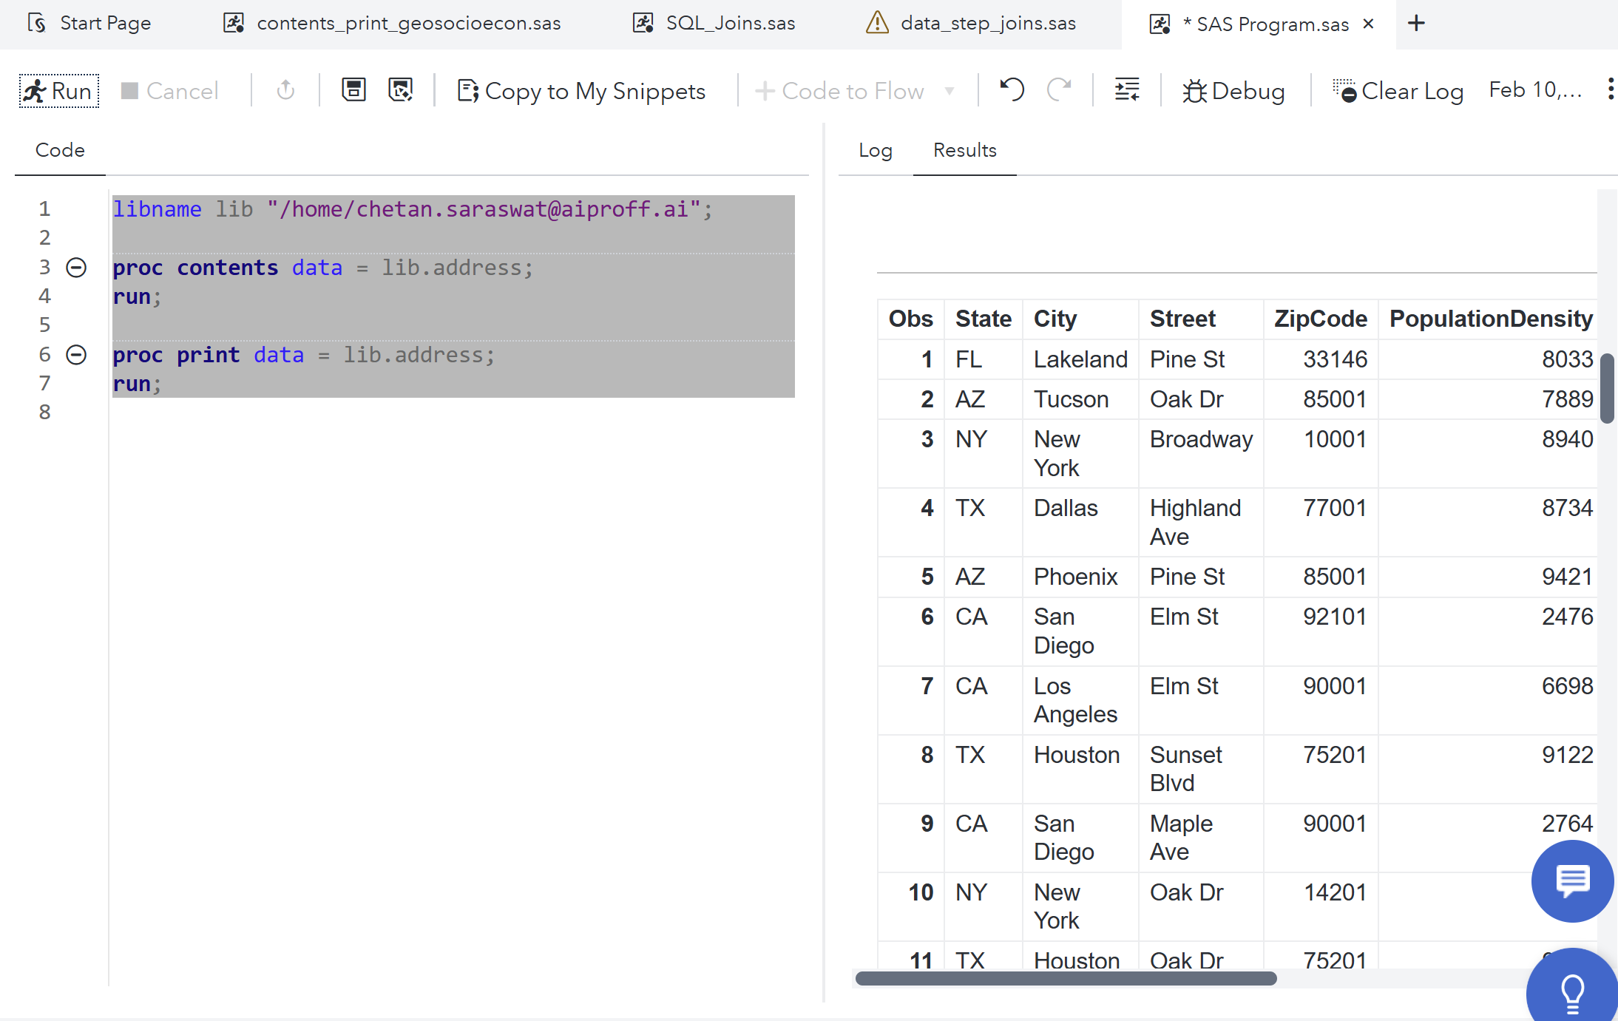
Let’s import some data to play around with

Slide 51
Data set Options
Data set options specify actions that apply only to the SAS data set with which they appear. They let you perform such operations as
renaming variables
selecting only the first or last n observations for processing
dropping variables from processing or from the output data set
specifying a password for a SAS data set.
Data set option is specified in parentheses after a SAS data set name. To specify several data set options, separate them with spaces.
(option-1=value-1<. . . option-n=value-n>)
These examples show data set options in SAS statements:
data scores(keep=team game1 game2 game3);
proc print data=new(drop=year);
set old(rename=(date=Start_Date));

Slide 52
Data set Options
Frequently used dataset options are as follows:
DROP= , Excludes variables from processing or from output SAS data sets
data plan1 plan2(drop=street zipcode);
set lib.address_v2;
run;
KEEP=, Specifies variables for processing or for writing to output SAS data sets
data plan3 (keep=state zipcode);
set lib.address_v2;
MedianIncome_THOUSAND=(MedianIncome)/1000;
run;

Slide 53
Data set Options
FIRSTOBS=, Causes processing to begin at a specified observation
data subset_5_20;
set lib.address_v2 (firstobs=5 obs=20);
run;
Few other important dataset options are OBS=, IN=, LABEL=, POINTOBS= , RENAME=, WHERE=
https://documentation.sas.com/doc/en/vdmmlcdc/8.1/ledsoptsref/p076qilh9hn5lzn17vr7x5xvxe7d.htm

Slide 54
SAS System Options
System options are instructions that affect your SAS session. They control the way that SAS performs operations such as SAS System initialization, hardware and software interfacing, and the input, processing, and output of jobs and SAS files.
The syntax for specifying system options in an OPTIONS statement is
OPTIONS option(s);
where
option -specifies one or more SAS system options you want to change.
The following example shows how to use the system options NODATE and LINESIZE= in an OPTIONS statement:
options nodate linesize=72;

Slide 55
SAS System Options
Differences between system options, data set options, and statement options.
System options remain in effect for all DATA and PROC steps in a SAS job or current process unless they are respecified.
Data set options apply to the processing of the SAS data set with which they appear. Some data set options have corresponding system options or LIBNAME statement options. For an individual data set, you can use the data set option to override the setting of these other options.
Statement options control the action of the statement in which they appear. Options in global statements, such as in the LIBNAME statement, can have a broader impact.

Slide 56
SAS System Options
Many system options and data set options share the same name and have the same function. System options remain in effect for all DATA and PROC steps in a SAS job or session unless they are respecified. The data set option, however, overrides the system option only for the step in which it appears.
options obs=100;
data one;
set two(obs=5);
run;
proc print data=three;
run;

Slide 57
SAS Variables
Creating Variables:
You can create variables in a DATA step in the following ways:
By using an assignment statement ( X(New) =Y(old) or X=‘ABC’)
By reading data with the INPUT statement in a DATA step (input Name $ Color $ Carats Owner $; )
By specifying a new variable in a FORMAT or INFORMAT statement
By specifying a new variable in a LENGTH statement(length Salesperson $20; )
By specifying a new variable in an ATTRIB statement.(Flavor="Cherry"; attrib Flavor format=$10.);

Slide 58
SAS Statements
A SAS statement is a series of items that may include keywords, SAS names, special characters, and operators. All SAS statements end with a semicolon. A SAS statement either requests SAS to perform an operation or gives information to the system.
Following is the list of frequently used SAS statements.
ARRAY DO until IF-subsetting LENGTH
ATTRIB DO while IF-THEN/ELSE MERGE
BY DROP %INCLUDE RETAIN
CARDS FILE INFORMAT SET
DATALINES INFILE INPUT SELECT
DELETE FILENAME KEEP SUM
DO FOOTNOTE LABEL WHERE
DO-iterative FORMAT LIBNAME TITLE
DATA OUTPUT RENAME STOP

Slide 59
SAS Statements
ATTRIB statement
Associates a format, informat, label, and/or length with one or more variables
ATTRIB variable-list(s) attribute-list(s) ;
Where,
variable-list names the variables that you want to associate with the attributes.
Attribute-list specifies one or more attributes to assign to variable-list.
Specify one or more of these attributes in the ATTRIB statement:
FORMAT=format
INFORMAT=informat
LABEL='label'
LENGTH=<$>length

Slide 60
SAS Statements
Examples of ATTRIB statement:
attrib cost length=4;
attrib saleday informat=mmddyy. format=worddate.;
attrib x y length=$4 label='TEST VARIABLE';
attrib x length=$4 label='TEST VARIABLE'
y length=$2 label='RESPONSE';
attrib month1-month12 label='MONTHLY SALES';

Slide 61
SAS Statements
CARDS/ DATALINES statement
Indicates that data lines follow.
Use the DATALINES statement with an INPUT statement to read data that you enter directly in the program, rather than data stored in an external file.
The syntax for DATALINES statement is as follows:
DATALINES;
Example of a DATALINES statement is as follows:
data person;
input name $ dept $;
datalines;
John Sales
Mary Accounting
;

Slide 62
SAS Statements
The DATALINES statement is the last statement in the DATA step and immediately precedes the first data line. Use a null statement (a single semicolon) to indicate the end of the input data.
You can use only one DATALINES statement in a DATA step. Use separate DATA steps to enter multiple sets of data.
Data lines cannot contain semicolons. Use DATALINES4 when your data contain semicolons.
The DATALINES statement does not provide input options for reading data. However, you can access some options by using the DATALINES statement in conjunction with an INFILE statement

Slide 63
SAS Statements
Example of a DATALINES statement with INFILE statement:
data person;
infile datalines delimiter=',';
input name $ dept $;
datalines;
John,Sales
Mary,Acctng
;
Example of a DATALINES4 statement:
data biblio;
input number citation $50.;
datalines4;
KIRK, 1988 2 LIN ET AL., 1995;BRADY, 1993
3 BERG, 1990; ROA, 1994; WILLIAMS, 1992
;;;;
Follow the data lines with four consecutive semicolons that are located in columns 1 through 4.

Slide 64
SAS Statements
DELETE statement
Stops processing the current observation
Is used in a DATA step
When DELETE executes, the current observation is not written to a data set, and SAS returns immediately to the beginning of the DATA step for the next iteration.
The syntax for DELETE statement is as follows:
DELETE;
Example for DELETE statement is as follows:
data topsales;
infile file-specification;
input region office product yrsales;
if yrsales<100000 then delete;
run;

Slide 65
SAS Statements
The DELETE statement is often used in a THEN clause of an IF-THEN statement or as part of a conditionally executed DO group.
Use the DELETE statement when it is easier to specify a condition that excludes observations from the data set or when there is no need to continue processing the DATA step statements for the current observation.
Use the subsetting IF statement when it is easier to specify a condition for including observations.

Slide 66
SAS Statements
SAS Code – do_retain_others.sas
DO statement
Designates a group of statements to be executed as a unit
Is used in a DATA step
The syntax for DO statement is as follows:
DO; ...more SAS statements...
END;
The DO statement is the simplest form of DO group processing. The statements between the DO and END statements are called a DO group. You can nest DO statements within DO groups.
A simple DO statement is often used within IF-THEN/ELSE statements to designate a group of statements to be executed depending on whether the IF condition is true or false

Slide 67
SAS Statements
Example for a DO statement:
if years>5 then do;
months=years*12;
put years= months=;
end;
else yrsleft=5-years;

Slide 68
SAS Statements
DO Iterative statement:
Executes statements between DO and END repetitively based on the value of an index variable
The syntax is as follows:
DO index-variable=specification-1<,...specification-n>;
more SAS statements
END;
where
index-variable controls the execution of the DO group
specification includes start, stop, and increment values
SAS statements create, modify, or process variables
END terminates the loop.

Slide 69
SAS Statements
When creating a DO loop with the iterative DO statement, you must specify an index variable. The index variable stores the value of the current iteration of the DO loop.
Next, specify the conditions that execute the DO loop. A simple specification contains a start value, a stop value, and an increment value for the DO loop.
DO index-variable=start TO stop BY increment;
more SAS statements
END;
The start value specifies the initial value of the index variable.
The TO clause specifies the stop value. The stop value is the last index value that executes the DO loop.
The BY clause specifies an increment value for the index variable.

Slide 70
SAS Statements
The start, stop, and increment values can be any number, numeric variable, or SAS expression that results in a number. The BY clause is optional. Typically, you want the DO loop to increment by 1 for each iteration. If you do not specify a BY clause, the default increment value is 1.
For example, the specification below increments the index variable by 1, resulting in quiz values of 1, 2, 3, 4, 5:
do quiz=1 to 5;
However, this specification increments the index variable by 2, resulting in rows values of 2, 4, 6, 8, 10, 12:
do rows=2 to 12 by 2;

Slide 71
SAS Statements
The following examples generate data with DO loop:
Data earnings;
Amount=1000;
Rate=.075/12;
do month=1 to 12;
Earned+(amount+earned)*(rate);
end;
run;
data earnings;
Amount=1000;
Rate=.075/12;
do month=1 to 12;
Earned+(amount+earned)*(rate);
OUTPUT;
end;
run;
Note the difference between the DO loops.
Also note the difference in the values of the
Index variable stored at the end of each data
Step.

Slide 72
SAS Statements
When you use a negative BY clause value, the start value must always be greater than the stop value in order to decrease the index variable during each iteration.
You can also specify how many times a DO loop executes by listing items in a series.
DO index-variable=2,5,9,13,27;
more SAS statements
END;
When the DO loop executes, it executes once for each item in the series. The index variable equals the value of the current item. You must separate each item in the series with a comma.

Slide 73
SAS Statements
To list items in a series, you must specify either
all numeric values
DO index-variable=2,5,9,13,27;
more SAS statements
END;
all character values, with each value enclosed in quotation marks
DO index-variable='MON','TUE','WED','THR','FRI';
more SAS statements
END;
all variable names.
DO index-variable=win,place,show;
more SAS statements
END;
Variable names must represent either all numeric or all character values. Do not enclose variable names in quotation marks.

Slide 74
SAS Statements
Iterative DO statements can be executed within a DO loop. Putting a DO loop within a DO loop is called nesting.
do i=1 to 20;
more executable statements
do j=1 to 10;
more executable statements
end;
more executable statements
end;
Example of a nested do loop:
data test;
do i=1 to 5;
do j=1 to 4;
x+1;
end;
end;
run;
How many times will the nested do loop execute?

Slide 75
SAS Statements
DO UNTIL statement:
The DO UNTIL statement executes a DO loop until a condition is true.
General form of DO UNTIL statement:
DO UNTIL(expression);
more SAS statements
END;
where expression is a valid SAS expression enclosed in parentheses
The expression is not evaluated until the bottom of the loop, so a DO UNTIL loop always executes at least once.
When the expression is evaluated as true, the DO loop is not executed again.

Slide 76
SAS Statements
Example of a DO UNTIL statement:
data work.test;
x=15;
do until(x>12);
x+1;
end;
run;
How many times will the loop execute?
What will be the value of X after the completion of the DATA step?

Slide 77
SAS Statements
DO WHILE statement:
Executes statements repetitively while a condition is true.
General form of DO WHILE statement is as follows:
DO WHILE(expression);
more SAS statements
END;
where expression is a valid SAS expression enclosed in parentheses
The statements execute while the expression is true. An important difference between the DO UNTIL and DO WHILE statements is that the DO WHILE expression is evaluated at the top of the DO loop. If the expression is false the first time it is evaluated, the DO loop never executes.

Slide 78
SAS Statements
Example of a DO WHILE statement:
data work.test;
x=15;
do while(x<12);
x+1;
end;
run;
How many times will the loop execute?
What will be the value of X after the completion of the DATA step?

Slide 79
SAS Statements
Using Conditional Clauses with the Iterative DO Statement.
You can add the UNTIL or WHILE expression to an iterative DO statement to further control the number of iterations.
This iterative DO statement enables you to execute the DO loop until Capital is greater than 50000 or the DO loop executes ten times, whichever occurs first.
data work.invest(drop=i);
do i=1 to 10 until(capital>50000);
Year+1;
Capital+2000;
capital+capital*.10;
end;
run;

Slide 80
SAS Statements
DROP statement:
Excludes variables from output SAS data sets
Is used in a DATA step only. It cannot be used in a PROC step.
DROP variable-list;
variable-list specifies the names of the variables to omit from the output data set.
data inventry excess;
drop purchase repair;
infile file-specification;
input unit part purchase repair;
totcost=sum(purchase,repair);
If unit > 100 then output excess;
Else output inventory;
run;

Slide 81
SAS Statements
The DROP statement differs from the DROP= data set option in the following ways:
You cannot use the DROP statement in SAS procedure steps.
The DROP statement applies to all output data sets that are named in the DATA statement. To exclude variables from some data sets but not from others, use the DROP= data set option in the DATA statement.
The KEEP statement is a parallel statement that specifies a list of variables to write to output data sets. Use the KEEP statement instead of the DROP statement if the number of variables to include is significantly smaller than the number to omit.
Do not confuse the DROP statement with the DELETE statement. The DROP statement excludes variables from output data sets; the DELETE statement excludes observations.

Slide 82
SAS Statements
IF, Subsetting
Continues processing only those observations that meet the condition
IF expression;
Where expression is any SAS expression.
The subsetting IF statement causes the DATA step to continue processing only those raw data records or those observations from a SAS data set that meet the condition of the expression that is specified in the IF statement. That is, if the expression is true for the observation or record (its value is neither 0 nor missing), SAS continues to execute statements in the DATA step and includes the current observation in the data set. The resulting SAS data set or data sets contain a subset of the original external file or SAS data set.

Slide 83
SAS Statements
If the expression is false (its value is 0 or missing), no further statements are processed for that observation or record, the current observation is not written to the data set, and the remaining program statements in the DATA step are not executed. SAS immediately returns to the beginning of the DATA step because the subsetting IF statement does not require additional statements to stop processing observations.
The subsetting IF statement is equivalent to this IF-THEN statement:
if not (expression) then delete;
Subsetting IF statement can be used only in a DATA step. It cannot be used in a PROC step.

Slide 84
SAS Statements
Example of a subsetting IF statement:
Data Senior_Citizen;
Set Demog;
If age > 60;
Run;

Slide 85
SAS Statements
IF-THEN/ELSE statement
Executes a SAS statement for observations that meet specific conditions
SAS evaluates the expression in an IF-THEN statement to produce a result that is either nonzero, zero, or missing. A nonzero and nonmissing result causes the expression to be true; a result of zero or missing causes the expression to be false.
The general form of the IF-THEN/ELSE statement is as follows:
IF expression THEN statement;
<ELSE statement;>

Slide 86
SAS Statements
Examples of IF-THEN/ELSE statement:
if status='OK' and type=3 then count+1;
if x=0 then
if y ne 0 then put 'X ZERO, Y NONZERO';
else put 'X ZERO, Y ZERO';
else put 'X NONZERO';

Slide 87
SAS Statements
LABEL statement
Assigns descriptive labels to variables
The general form of LABEL statement is as follows:
LABEL variable-1='label-1' . . . <variable-n='label-n'>;
Using a LABEL statement in a DATA step permanently associates labels with variables by affecting the descriptor information of the SAS data set that contains the variables. You can associate any number of variables with labels in a single LABEL statement.
Using a LABEL statement in a PROC step causes the association of label to be temporary and only for that PROC step.

Slide 88
SAS Statements
Example of LABEL statement:
label compound='Type of Drug';
label date="Today's Date ";
label n='Mark''s Experiment Number';
label score1="Grade on April 1 Test"
score2="Grade on May 1 Test";
This example removes an existing label:
data rtest;
set rtest;
label x=' ';
run;

Slide 89
SAS Statements
LENGTH statement
Specifies the number of bytes for storing variables
Is used in a data step
The general form of the length statement is as follows:
LENGTH variable(s) length;
To specify the length of a character variable, add a dollar sign ($) after the variable name: LENGTH variable $ length;
Make sure the LENGTH statement appears before any other reference to the variable in the DATA step. The length of a new variable is determined by the first reference in the DATA step. If the variable has been created by an assignment statement, later use of the LENGTH statement will not alter its size.

Slide 90
SAS Statements
Examples of length statement:
length Type $ 8;
length Address1 Address2 Address3 $ 200;
length FirstName $ 12 LastName $ 16;
data finance.newloan;
set finance.records(drop=amount rate);
length Type $ 8;
TotalLoan+payment;
if code='1' then Type='Fixed';
else Type='Variable';
run;
What will be the effect of excluding the length statement in this data step?

Slide 91
SAS Statements
What will be the length of the variable City?
data census.totals;
set adjust.rates;
if adjustedrate=3 then City='Minneapolis';
else if adjrate=5 then City='Chicago';
TotalPopulation+citypopulation;
run;

Slide 92
SAS Statements
RETAIN statement
Causes a variable that is created by an INPUT or assignment statement to retain its value from one iteration of the DATA step to the next
Is used in a DATA step
The general form of RETAIN is as follows:
RETAIN <element-list(s) <initial-value(s) | (initial-value-1) | (initial-value-list-1) > < . . . element-list-n <initial-value-n | (initial-value-n ) | (initial-value-list-n)>>>;

Slide 93
SAS Statements
Example of RETAIN statement:
This RETAIN statement retains the values of variable Tot_Sales from one iteration of the DATA step to the next:
Data Sales;
Set Qtr1;
Retain Tot_Sales 15;
Tot_Sales = Tot_sales + Sale_amount;
Run;
Without a RETAIN statement, SAS automatically sets variables that are assigned values by an INPUT or assignment statement to missing before each iteration of the DATA step.
If you omit initial-value, the initial value is missing.
What will be the effect of not using a RETAIN statement?
What will be the effect of not having the assignment statement for Tot_Sales?

Slide 94
SAS Statements
Some more examples of RETAIN statement are as follows:
This RETAIN statement retains the values of variables MONTH1 through MONTH5 from one iteration of the DATA step to the next:
retain month1-month5;
This RETAIN statement retains the values of nine variables and sets their initial values
retain month1-month5 1 year 0 a b c 'XYZ';
The values of MONTH1 through MONTH5 are set initially to 1; YEAR is set to 0; variables A, B, and C are each set to the character value
Both of these statements assign initial values to VAR1 through VAR4:
retain var1-var4 (1 2 3 4);
retain var1-var4 (1,2,3,4);

Slide 95
SAS Statements
This RETAIN statement assigns the initial value 1 to the variable MONTH1 only:
retain month1-month5 (1);
Variables MONTH2 through MONTH5 are set to missing initially.

Slide 96
SAS Statements
SUM statement
To create a variable that accumulates values down observations, you can use a sum statement in your DATA step.
The general form of SUM statement is as follows:
variable+expression;
where,
variable is a numeric variable that accumulates and retains values down observations. The variable is automatically set to 0 before the first observation is read.
expression is any valid SAS expression.
If the expression produces a missing value, SAS software treats it as a 0

Slide 97
SAS Statements
The sum statement adds the result of the expression on the right side of the plus sign (+) to the numeric variable on the left side of the plus sign. Then the sum statement retains the new value for use in subsequent observations.
data finance.newloan;
set finance.records(drop=amount rate);
TotalLoan+payment;
run;
The sum statement is equivalent to using
the SUM function and the RETAIN statement, as shown here:
retain variable 0;
variable=sum(variable,expression);
TotalLoan | Payment | Prev Total
0.00
467.43 | 467.43 | 0.00
1426.00 | 958.57 | 467.43
1426.00 | . | 1426.00

Slide 98
SAS Statements
Some more examples of SUM statement are as follows:
balance+(-debit);
sumxsq+x*x;
nx+(x ne .);
if status='ready' then OK+1;

Slide 99
Reading Raw data
Consider the following raw data file
The file has the following layout:
Contents of Myfile
101 Joe M 19780305
123 Beth F 19890809
131 Nancy F 19580226
121 Dave M 19851103
135 Betty F 19820815
Field Name | Starting Column | Ending Column | Description of Field
Id | 1 | 3 | Patient Id
Name | 5 | 9 | Patient Name
Sex | 11 | 11 | Patient’s Gender
Dob | 13 | 20 | Patients DOB

Slide 100
Reading Raw data
To read the raw data file, the DATA step must give the following instructions to the SAS System:
reference the external text file to be read
name the SAS data set
identify the external file
describe the data values to be read.

Slide 101
Reading Raw data
Action | SAS Statement
Reference SAS data library | LIBNAME statement
Reference external file | FILENAME statement
Name SAS data set | DATA statement
Identify external file | INFILE statement
Describe data | INPUT statement
Execute DATA step | RUN statement
List the data | PROC PRINT statement
Execute final program step | RUN statement

Slide 102
Reading Raw data
Libname Mylib ‘C:/Training/SAS/Examples’;
Filename Myfile ‘C:/Training/SAS/Data.txt’;
Data Mylib.Test1;
Infile Myfile;
Informat Dob YYMMDD10.;
Input Id 1-3 Name $ 5-9 Sex $ 11-11 Dob 13-20;
Age = (Today() – Dob) / 365;
Format Dob YYMMDD10.;
Label Id = "Patient Id"
Name = "Patient Name"
Sex = "Gender"
Dob = "Date of Birth";
Run;
Proc Print Data = Mylib.Test1; Run;

Slide 103
Reading Raw data
LIBNAME statement
Associates or disassociates a SAS data library with a libref (a shortcut name)
The libref is used as the first part of the two-level dataset name.
Basic form of LIBNAME statement:
LIBNAME libref 'SAS-data-library';
where
libref is 1 to 8 characters long; begins with a letter or underscore; and contains only letters, numbers, or underscores.
SAS-data-library is the name of the SAS library where the file is stored. The specification of the physical name of the library differs by operating system and machine.

Slide 104
Reading Raw data
The LIBNAME statement below assigns the libref Mylib to the SAS data library C:/Training/SAS/Examples in the Windows environment.
Libname Mylib ‘C:/Training/SAS/Examples’;
The libref is used as the first part of the two-level dataset name.
Data Mylib.Test1;
The LIBNAME statement is global, which means that its settings remain in effect until you modify them, cancel them, or end your SAS session.
Therefore, the LIBNAME statement assigns the libref for the current SAS session only. You must assign a libref each time you begin a SAS session in order to access SAS files stored in a permanent SAS data library.
Work is the default libref for a temporary SAS data library
Sometimes a engine is also specified with the LIBNAME statement

Slide 105
Reading Raw data
FILENAME statement
Associates or disassosciates a SAS fileref with an external file
In the same way that you assign a libref by using a LIBNAME statement, you assign a fileref by using a FILENAME statement.
Librefs reference SAS data libraries while Filerefs reference external files.
Basic form of FILENAME statement:
FILENAME fileref 'filename';
where fileref is a valid SAS name that you associate with an external file and 'filename' is the fully qualified name or location of the file

Slide 106
Reading Raw data
The FILENAME statement below assigns the libref Myfile to the SAS data library C:/Training/SAS/Data.txt in the Windows environment.
Filename Myfile ‘C:/Training/SAS/Data.txt’;
Infile Myfile;
FILENAME statement can also be used to associate a fileref with an aggregate storage location, such as a directory that contains a number of external files.
Filename Myfile ‘C:/Training/SAS’;
Infile Myfile(Data.txt);
Both the LIBNAME and FILENAME statements are global. That is, they remain in effect until you change them, cancel them, or end your SAS session.

Slide 107
Reading Raw data
INFILE statement
Identifies an external file to read with an INPUT statement
The general form of INFILE statement is as follows:
INFILE file-specification <options> <host-options>;
Where,
file-specification identifies the source of the input data records
And can have the following forms:
'external-file' -
fileref
fileref(file)
DATALINES | DATALINES4
CARDS | CARDS4

Slide 108
Reading Raw data
Few Examples of INFILE statements:
INFILE ‘C:/Training/SAS/Data.txt’;’
INFILE Myfile;
INFILE Myfile(Data.txt);
INFILE DATALINES;
INFILE Myfile DLM = ‘,’ END = Fil1 FIRSTOBS = 2 OBS = 45;
INFILE Myfile PAD LRECL = n;

Slide 109
Reading Raw data
DATA statement:
Begins a DATA step and provides names for any output SAS data sets
The general form of the DATA statement is as follows:
DATA <data-set-name-1 <(data-set-options-1)>> <. . .data-set-name-n <(data-set-options-n)>>;
DATA _NULL_;
A example of a DATA statement are:
DATA _Teens _Adults Senior_Citizen
Abnormal_Observation (Drop = Height Weight) ;
If Age ne . AND Age < 18 then Output _Teens;
Else if 18 <= Age < 60 then output _Adults;
Else if Age> = 60 then output Senior_Citizen;
Else output Abnormal_Observation;
Run;

Slide 110
Reading Raw data
INPUT statement
Describes the arrangement of values in the input data record and assigns input values to the corresponding SAS variables
Can be used to read data in free format, data in fixed columns, data in non-standard format.
Based on the way the data is arranged in the file to be read, the INPUT statement is divided into following forms:
Column Input
Formatted Input
List Input
Modified List Input

Slide 111
Reading Raw data - Column INPUT
The following external file contains data arranged in columns or fixed fields.
input Item $ 1-13 IDnum $ 15-19
InStock 21-22 BackOrd 24-25;
The above INPUT statement lists the variables with their corresponding column locations in order from left to right. However, one of the features of column input is the capability to read fields in any order.
BIRD FEEDER LG088 3 20 GLASS MUGS SB082 6 12 GLASS TRAY BQ049 12 6 PADDED HANGRS MN256 15 20 JEWELRY BOX AJ498 23 0 RED APRON AQ072 9 12 CRYSTAL VASE AQ672 27 0 PICNIC BASKET LS930 21 0

Slide 112
Reading Raw data - Column INPUT
The Column INPUT has the following additional features:
Character variables values can be up to 32K and can contain embedded blanks
No placeholder is required for missing data. A blank field is read as missing and does not cause other fields to be read incorrectly
Fields or parts of fields can be reread.
Fields do not have to be separated by blanks or other delimiters.
Whenever a raw data is organized in fixed fields the Column INPUT can be used to read standard data only.
Standard numeric data values can only contain numbers, decimal points, numbers in scientific, or E, notation (23E4) ,minus signs.
Nonstandard numeric data include values that contain special characters, such as percent signs (%), dollar signs ($), and commas (,), date and time values, data in fraction, integer binary, real binary and hexadecimal forms

Slide 113
Reading Raw data - Formatted INPUT
For reading both standard and non-standard data organized in fixed fields the Formatted INPUT can be used.
The general form of Formatted INPUT is as follows:
INPUT pointer-control variable informat.;
There are two types of pointer controls and are as follows:
The @n moves the input pointer to a specific column number.
The +n moves the input pointer forward, to a column number relative to the current position.
input @9 FirstName $5. @1 LastName $7. @15 JobTitle 3. @19 Salary comma9.;
EVANS DONNY 112 29,996.63
HELMS LISA 105 18,567.23
HIGGINS JOHN 111 25,309.00

Slide 114
Reading Raw data - Formatted INPUT
With formatted input, the column pointer control moves to the first column after the field just read.
input LastName $7. +1 FirstName $5. +5 Salary comma9. @15 JobTitle 3.;
You can use the notation +(-n) to move the +n pointer control backwards
The character variables in the program data vector are defined with the exact length specified by the informat
By default, SAS software stores numeric values (no matter how many digits the value contains) as floating point numbers in 8 bytes of storage. The length of a stored numeric variable is not affected by an informat's width or other column specifications in an INPUT statement.
EVANS DONNY 112 29,996.63
HELMS LISA 105 18,567.23
HIGGINS JOHN 111 25,309.00

Slide 115
Reading Raw data - List INPUT
The List INPUT is used to read the raw data present in free format.
The general form of List INPUT is as follows:
INPUT variable <$>;
input Gender $ Age Bankcard FreqBank Deptcard FreqDept;
Because list input, by default, does not specify column locations,
all fields must be separated by at least one blank or other delimiter
fields must be read in order from left to right
you cannot skip or reread fields.
MALE 27 1 8 0 0 FEMALE 29 3 14 5 10 FEMALE 34 2 10 3 3 MALE 35 2 12 4 8 FEMALE 36 4 16 3 7

Slide 116
Reading Raw data - List INPUT
Use DLM = statement option on the INFILE statement to specify a delimiter other than blank.
Use DSD statement option on the INFILE statement if the consecutive delimiter are used in raw data to indicate missing values. With DSD option the default delimiter is a comma (,).
However, DLM = and DSD options can be used together to specify a delimiter other than comma (,) and to indicate to SAS that consecutive delimiters in raw data are to be interpreted as missing value.
Use MISSOVER statement option with INFILE statement to indicate SAS if a data line contains missing values towards the end then SAS should not proceed to read the values from subsequent data line.
MISSOVER option works only with missing values towards the end of the record.

Slide 117
Reading Raw data - List INPUT
When list input is used to read raw data, character values are assigned a default length of 8. Use LENGTH statement to specify a length other than the default length.
If a character variable is not allowed to have a default length and the data for that variable is having more than 8 characters then truncated data will be stored in that variable.

Slide 118
Reading Raw data - Modified List INPUT
The modifiers ampersand (&) and colon (:) when used with list input results in a modified list input.
The ampersand (&) modifier is used to read character values that contain embedded blanks.
The & indicates that a character value that is being read with list input may have one or more single embedded blanks. The value is read until two or more consecutive blanks are encountered. The & modifier precedes a specified informat if one is used.
two consecutive blanks are required delimiters when using the & modifier
The colon (:) modifier is used to read nonstandard data values and character values longer than eight characters, but without embedded blanks.
The : indicates that values are read until a blank (or other delimiter) is encountered, and then an informat is applied. If an informat for reading character values is specified, the w value determines the variable's length, overriding the default length.

Slide 119
Reading Raw data - Modified List INPUT
Consider the following data and the corresponding INPUT statement.
data perm.cityrank;
infile topten;
input Rank City & $12. Pop86 : comma.;
Remember that list input reads values until the next blank is detected. The default length of numeric variables is 8 bytes, so you don't need to specify a w value to determine the length of a numeric variable.
This is different from using a numeric informat with formatted input. In that case, you must specify a w value in order to determine the number of columns to be read.
The format $12. Used for the variable City sets its length to 12. The w value of 12 does indicate the number of columns that are to be read.
1 NEW YORK 7,262,700 2 LOS ANGELES 3,259,340 3 CHICAGO 3,009,530

Slide 120
Reading Raw data - Modified List INPUT
That is, informats work differently in modified list input than they do in formatted input.
With formatted input, the informat determines both the length of character variables and the number of columns to be read. The same number of columns are read from each record.
The informat in modified list input determines only the length of the variable, not the number of columns to be read. Here, the raw data values are read until two consecutive blanks are encountered.

Slide 121
Reading Raw data
Summarising different input styles:
Column standard data values in fixed fields
Formatted nonstandard data values in fixed fields
List data values that are not arranged in fixed fields, but are separated by blanks or other delimiters
At times, input styles might have to be mixed depending upon the file layout.

Slide 122
Reading Raw data
Consider the following file layout:
input SSN $ 1-11 @13 HireDate date7. @21 Salary comma6. Department : $9. Phone;
The INPUT statement uses a Column Input for the first field, Formatted Input for the next two fields and List Input for the last field.
209-20-3721 07JAN78 41,983 SALES 2896 223-96-8933 03MAY86 27,356 EDUCATION 2344 232-18-3485 17AUG81 33,167 MARKETING 2674 251-25-9392 08SEP84 34,033 RESEARCH 2956

Slide 123
Reading Raw data -Line Pointer Controls
Information for one observation can be spread out over several records.
One can use either multiple INPUT statements to read the records OR a more convenient way of using one INPUT statement along with Line pointers can be used.
There are two types of Line pointers:
The forward slash (/) specifies a line location relative to the current one.
The #n specifies the absolute number of the line to which you want to move the pointer.

Slide 124
Reading Raw data -Line Pointer Controls
The forward slash (/) line pointer control is used to read multiple records in sequential order.
The / advances the input pointer to the next record.
The / line pointer control only advances the input pointer forward and must be specified after the instructions for reading the values in the current record.
input Lname $ 1-8 Fname $ 10-15 /
Department $ 1-12 JobCode $ 15-19 /
Salary comma10.;
It's important that there must be the same number of records in the external file for each observation being created. What will happen if it is not so?
ABRAMS THOMAS MARKETING SR01 $25,209.03
BARCLAY ROBERT EDUCATION IN01 $24,435.71
Note the position of semicolon

Slide 125
Reading Raw data -Line Pointer Controls
The #n line pointer is used to read multiple records in any order.
The #n specifies the absolute number of the line to which you want to move the pointer.
The #n pointer control can read records in any order; therefore, it must be specified before the instructions for reading values in a specific record.
input #2 Department $ 1-12 JobCode $ 15-19
#1 Lname $ 1-8 Fname $ 10-15
#3 Salary comma10.;
ABRAMS THOMAS MARKETING SR01 $25,209.03
BARCLAY ROBERT EDUCATION IN01 $24,435.71

Slide 126
Reading Raw data -Line Pointer Controls
The forward slash (/) line pointer and #n line pointer control can be combined to read multiple records in both sequential and nonsequential order.
data perm.patients;
infile patdata;
input #4 ID $5. #1 Fname $ Lname $ /
Address $23. /
City $ State $ Zip $ /
@7 Doctor $6.;
run;
An important point to note while reading in multiple records per observation is that there must be the same number of records for each observation being created
ALEX BEDWAN 609 WILTON MEADOW DRIVE GARNER NC 27529 XM034 FLOYD
ALISON BEYER 8521 HOLLY SPRINGS ROAD APEX NC 27502 XF124 LAWSON

Slide 127
Reading Raw data - Line Hold Specifiers
H 321 S. MAIN ST
P MARY E 21 F P WILLIAM M 23 M P SUSAN K 3 F
H 324 S. MAIN ST
P THOMAS H 79 M P WALTER S 46 M P ALICE A 42 F P MARYANN A 20 F P JOHN S 16 M
H 325A S. MAIN ST
P JAMES L 34 M P LIZA A 31 F
H 325B S. MAIN ST
P MARGO K 27 F P P WILLIAM R 27 M P ROBERT W 1 M
Consider the following file structure:
This file is hierarchical in nature in the sense
that there is one header record and one or more
than one detail record for each header record.
data perm.people (drop=type);
infile census;
retain Address;
input type $1. @;
if type='H' then input @3 Address $15.;
if type='P';
input @3 Name $10. @13 Age 3. @15 Gender $1.;
run;
The above DATA step will create one observation for each detail record.

Slide 128
Reading Raw data - Line Hold Specifiers
In order to create one observation for each header record the program may be modified as follows:
data perm.residnts (drop=type);
infile census end=last;
retain Address;
input type $1. @;
if type='H' then do;
if _n_ > 1 then output;
Total=0;
input Address $ 3-17; end;
else if type='P' then total+1;
if last then output;
run;

Slide 129
Reading Raw data - Line Hold Specifiers
SAS provides two line-hold specifiers.
The trailing at sign (@) enables the next INPUT statement to read from the current record in the same iteration of the DATA step.
The double trailing at sign (@@) enables the next INPUT statement to read from the current record across further iterations of the DATA step.
input name $20. @; or input name $20. @@;

Slide 130
Reading Raw data - Line Hold Specifiers
Trailing @ sign
Normally, each INPUT statement in a DATA step reads from a new record. But when the trailing @ is used, the following occurs:
the input pointer remains at the same line, rather than moving down to the next record.
the next INPUT statement (in the same iteration of the DATA step) continues reading the same record, rather than the new one
A record held by the trailing @ is automatically released when:
a subsequent INPUT statement without a line-hold specifier executes
control returns to the top of the DATA step to begin the next iteration.

Slide 131
Reading Raw data - Line Hold Specifiers
When the double trailing @@ is used , the INPUT statement holds the current record and reds the next value.
A record held by @@ is not released until
the input pointer moves past the end of the record.
an INPUT statement without a line-hold specifier executes
Input Score1 Score2 @;
Input Score;
Input Score1 Score2 @@;
102 92 78 103
84 23 36 75

Slide 132
Reading data from Dataset
SET statement
Is used to read observations from one or more SAS datasets.
To create the new data set, one can read a single data set, or one can concatenate two or more data sets. Concatenating appends the observations from one data set to another data set.
Specifying a single dataset name in the SET statement causes all the observations and the variables from that dataset to be read.
In order to limit observations to be read a subsetting IF, or a Where statement or a conditional statement can be used.
In order to select or drop variables KEEP or DROP dataset options or statements can be used.

Slide 133
Reading data from Dataset
Concatenating Datasets
To concatenate SAS data sets, you specify a list of data set names in the SET statement.
DATA output-SAS-data-set; SET SAS-data-set-1 SAS-data-set-2; RUN;
You can specify any number of data sets in the SET statement.
In concatenating, data sets in the SET statement are read sequentially, in the order in which they are listed, until all observations have been processed. The new data set contains all the variables from all the input data sets and the total number of records from all input data sets.
data concatenated;
set a b;
run;

Slide 134
How do we create permanent dataset here in SAS Studio
If you see closely, you will see a path in the properties of each file under SAS Home
That is user specific and persists through session timeouts as well
This is the path or libname wewill use to persists our code, datasets and files.

Slide 135
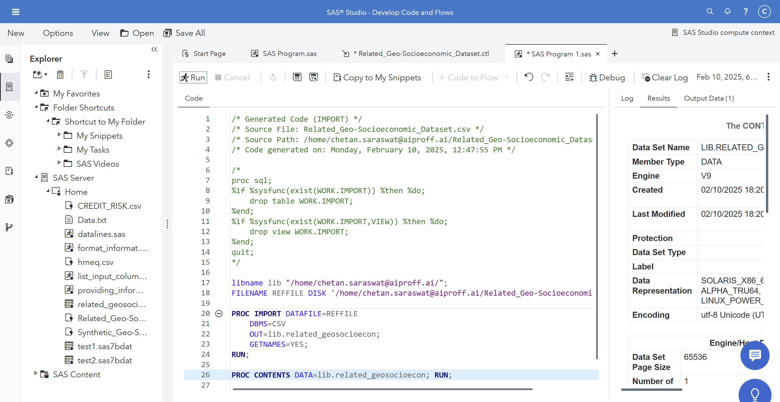
How do we create permanent dataset here in SAS Studio

Slide 136
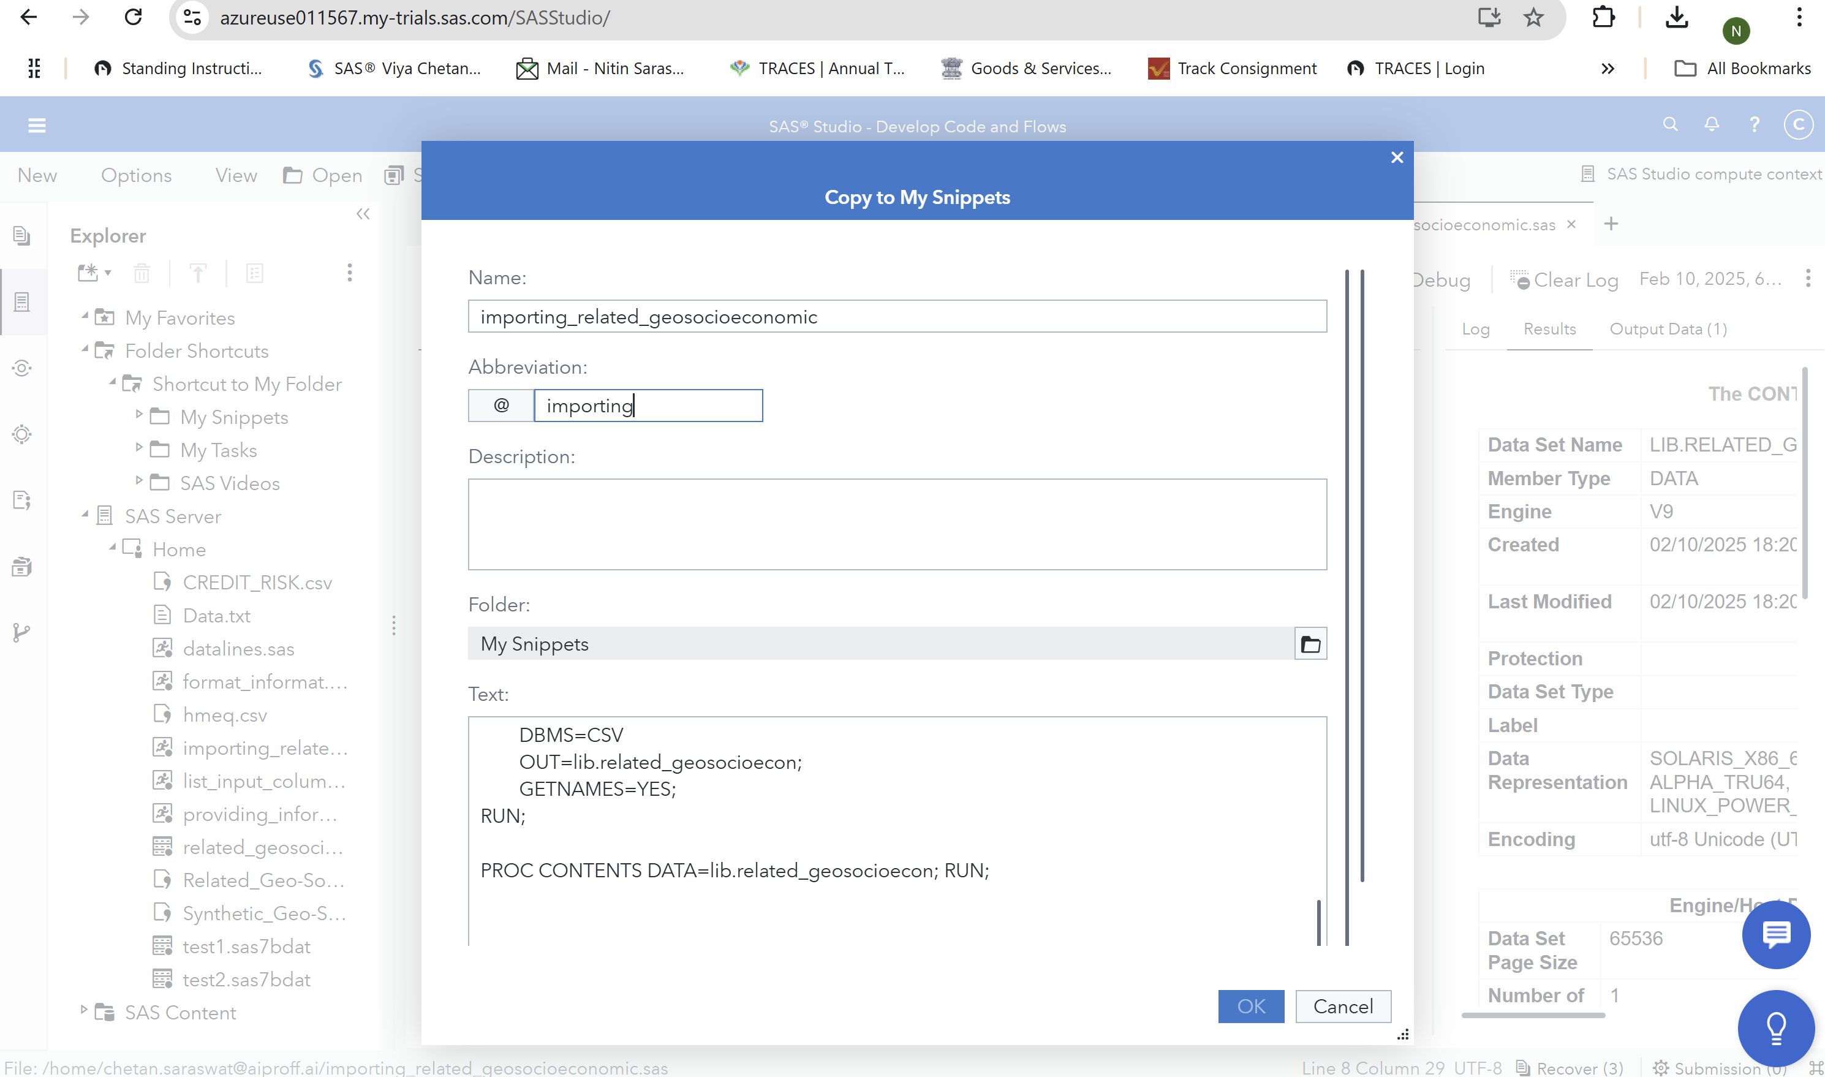
We can create code snippets that can be called later anywhere using @ invocation

Slide 137
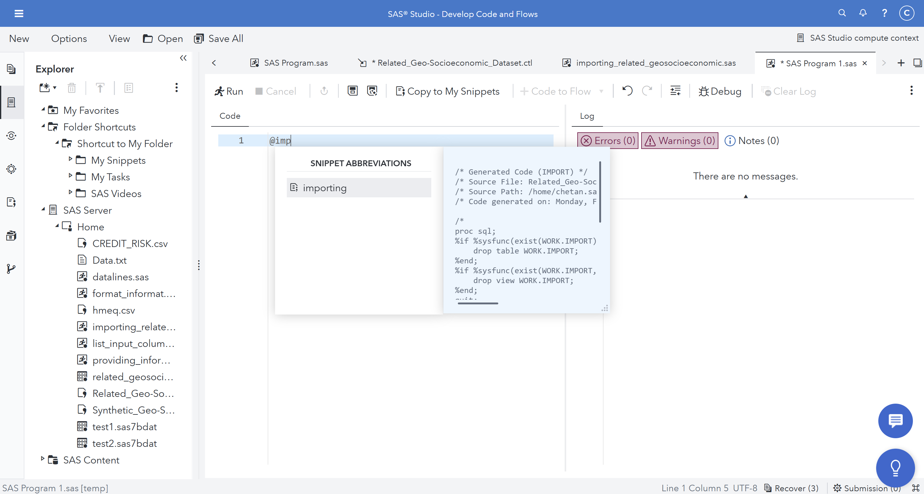
Calling the snippet in another code using @

Slide 138
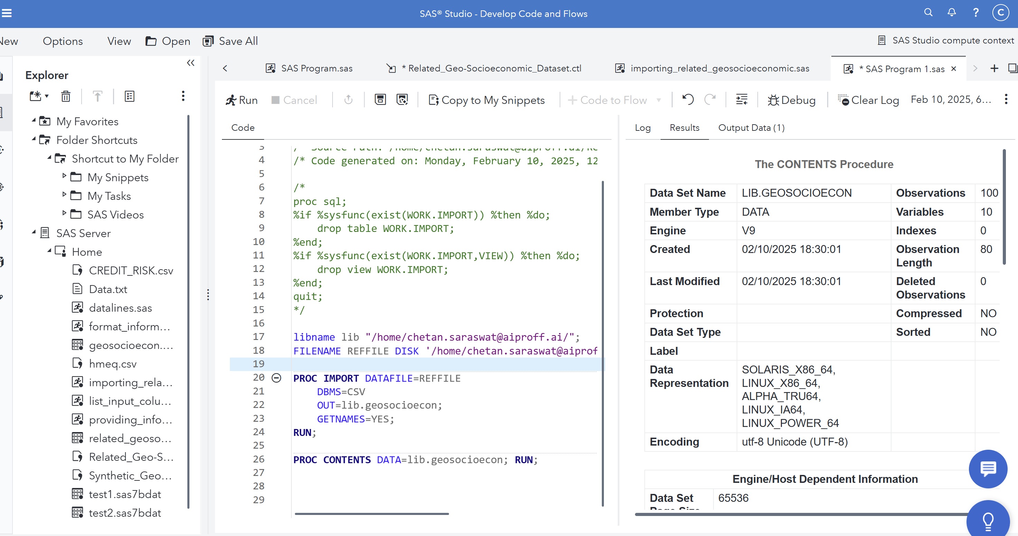
Using this snippet import the geo-socioeconomic csv file

Slide 139
Reading data from Dataset
The concatenation of the datasets ‘a’ and ‘b’ will result in the data in the output data set as follows:
Data Set B
Name | Age | Gender | Height
Beth | 41 | F | 160
Tom | 25 | M | 170
Data Set A
Name | Age | Gender
Joe | 18 | M
Tracy | 24 | F
Jim | 43 | M
Data set Concatenated
Name | Age | Gender | Height
Joe | 18 | M | .
Tracy | 24 | F | .
Jim | 43 | M | .
Beth | 41 | F | 160
Tom | 25 | M | 170

Slide 140
Reading data from Dataset
In concatenation, the number of observations in the new data set is the sum of the number of observations in the original data sets, and the order is all the observations from the first data set followed by all observations from the second data set, and so on.
The attributes of the variables, like the length and the format of the variables are determined from the dataset listed in the SET statement in which they occur first.
For example in the previous example, the attributes of the variables Name, Age, Gender come from the dataset A while that of variable Height come from dataset B.

Slide 141
Reading data from Dataset
One-to-One matching
Use multiple SET statements to perform one-to-one reading (also called one-to-one matching) of the specified data sets
The new data set contains all the variables from all the input data sets.
The number of observations in the new data set is the number of observations in the smallest original data set.
If the data sets contain common variables, the values that are read in from the last data set replace those read in from earlier ones

Slide 142
Reading data from Dataset
Consider the following example:
Data OnetoOne;
Set A; Set B;
Run;
Data Set A
Name | Age | Gender
Joe | 18 | M
Tracy | 24 | F
Jim | 43 | M
Data Set B
Name | Age | Height
Beth | 41 | 160
Tom | 25 | 170
Data set OnetoOne
Name | Age | Gender | Height
Beth | 41 | M | 160
Tom | 25 | F | 170

Slide 143
Reading data from Dataset
Interleaving Datasets
Use a single SET statement with a BY statement to interleave the specified data sets.
Data Interleave; Set A B;
By Age; Run;
The observations in the new data set are arranged by the values of the BY variable or variables, and within each BY group, by the order of the data sets in which they occur.
In order to understand the Interleaving of Datasets, it is imperative that the BY group processing is understood first.
BY Group processing
is a method of processing observations from one or more SAS data sets that are grouped or ordered by values of one or more common variables
The most common use of BY-group processing in the DATA step is to combine two or more SAS data sets by using the BY statement with a SET, MERGE, MODIFY, or UPDATE statement.

Slide 144
Reading data from Dataset
BY group processing (contd.)
BY variable names a variable or variables by which the data set is sorted or indexed. All data sets must be ordered or indexed on the values of the BY variable if you use the SET, MERGE, or UPDATE statements.
BY value is the value or formatted value of the BY variable.
BY group includes all observations with the same BY value. If you use more than one variable in a BY statement, a BY group is a group of observations with the same combination of values for these variables. Each BY group has a unique combination of values for the variables.
FIRST.Variable and LAST.Variable are variables that SAS creates for each BY variable. SAS sets FIRST.variable when it is processing the first observation in a BY group, and sets LAST.variable when it is processing the last observation in a BY group. This allows you to take different actions, based on whether processing is starting for a new BY group or ending for a BY group

Slide 145
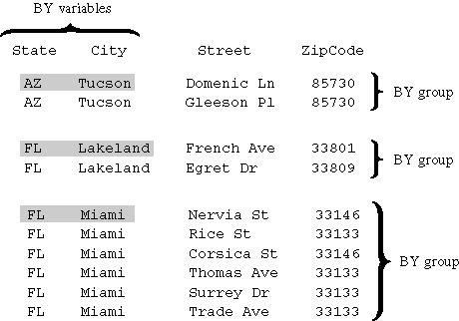
Reading data from Dataset
General form of BY statement :
BY variable(s);
The following figure represents
the results of processing your
data with two BY variables,
State and City
by State City;

Slide 146
Reading data from Dataset
The observations are arranged so that the observations for Arizona occur first. The observations within each value of State are arranged in order of the value of City. Each BY group has a unique combination of values for the variables State and City. For example, the BY value of the first BY group is AZ Tucson, and the BY value of the second BY group is FL Lakeland.
You can invoke BY-group processing in both DATA steps and PROC steps by using a BY statement.
For example, the following DATA step program uses the SET statement to combine observations from three SAS data sets by interleaving the files
data all_sales;
set region1 region2 region3;
by State City Zip;
... more SAS statements ...
run;

Slide 147
Reading data from Dataset
FIRST.Variable and LAST.Variable
In the DATA step, SAS identifies the beginning and end of each BY group by creating two temporary variables for each BY variable: FIRST.variable and LAST.variable.
These temporary variables are available for DATA step programming but are not added to the output data set.
Their values indicate whether an observation is
the first one in a BY group
the last one in a BY group
neither the first nor the last one in a BY group
both first and last, as is the case when there is only one observation in a BY group

Slide 148
Reading data from Dataset
When an observation is the first in a BY group, SAS sets the value of the FIRST.variable to 1. For all other observations in the BY group, the value of the FIRST.variable is 0.
When an observation is the last in a BY group, SAS sets the value of LAST.variable to 1. For all other observations in the BY group, the value of LAST.variable is 0.
If the observations are sorted by more than one BY variable, the FIRST.variable for each variable in the BY statement is set to 1 at the first occurrence of a new value for the variable.

Slide 149
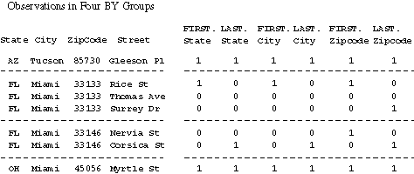
Reading data from Dataset
Consider the following BY statement: by State City ZipCode;
SAS creates the following temporary variables: FIRST.State, LAST.State, FIRST.City, LAST.City, FIRST.ZipCode, and LAST.ZipCode.

Slide 150
Reading data from Dataset
Returning back to Interleaving consider the following example.
Data Set A
Name | Age | Gender
Danny | 25 | M
Jim | 43 | M
Joe | 18 | M
Tracy | 24 | F
Data Set B
Name | Age | Gender
Beth | 41 | F
Danny | 36 | F
Jim | 25 | M
Data Set Interleave
Name | Age | Gender
Beth | 41 | F
Danny | 25 | M
Danny | 36 | F
Jim | 43 | M
Jim | 25 | M
Joe | 18 | M
Tracy | 24 | F

Slide 151
Reading data from Dataset
MERGE Statement
Joins observations from two or more SAS data sets into single observations
General form of MERGE statement
DATA output-SAS-data-set; MERGE SAS-data-set-1 SAS-data-set-2; BY variable(s); RUN;
where
output-SAS-data-set names the data set to be created
SAS-data-set-1 and SAS-data-set-2 are input data sets
variable(s) in the BY statement specifies the variable(s) whose values are used to match observations.
One can specify any number of input data sets in the MERGE statement.

Slide 152
Reading data from Dataset
One- to – One Merging
Basic DATA step one-to-one merging produces an output data set that contains values from all observations in all input data sets.
Data Mrge;
Merge A B;
Run;
Data Set A
Name | Age | Gender
Danny | 25 | M
Jim | 43 | M
Joe | 18 | M
Tracy | 24 | F
Data Set B
Name | Gender
Beth | F
Danny | F
Jim | M
Data Set Mrge
Name | Age | Gender
Beth | 25 | F
Danny | 43 | F
Jim | 18 | M
Tracy | 24 | F

Slide 153
Reading data from Dataset
One-to-one merging combines observations from two or more SAS data sets into a single observation in a new data set.
To perform a one-to-one merge, use the MERGE statement without a BY statement.
SAS combines the first observation from all data sets that are named in the MERGE statement into the first observation in the new data set, the second observation from all data sets into the second observation in the new data set, and so on.
In a one-to-one merge, the number of observations in the new data set is equal to the number of observations in the largest data set named in the MERGE statement.

Slide 154
Reading data from Dataset
Match Merging
Basic DATA step match-merging produces an output data set that contains values from all observations in all input data sets.
To perform a match-merge, use a BY statement immediately after the MERGE statement. The variables in the BY statement must be common to all data sets. Only one BY statement can accompany each MERGE statement in a DATA step.
In DATA step match-merging, all data sets to be merged must be sorted or indexed by the values of a common variable (also known as a BY variable). The common variable must have the same type and length in all data sets to be merged.
The number of observations in the new data set is the sum of the largest number of observations in each BY group in all data sets.

Slide 155
Reading data from Dataset
Sometimes there may be variables with the same name in more than one input data set. In this case, DATA step match-merging overwrites values of the like-named variable in the first data set in which it appears with values of the like-named variable in subsequent data sets.
Data Mrge;
Merge A B;
BY Name;
Run;
Data Set Mrge
Name | Age | Gender
Beth | . | F
Danny | 25 | F
Jim | 43 | M
Joe | 18 | M
Tracy | 24 | F
Data Set B
Name | Gender
Beth | F
Danny | F
Jim | M
Data Set A
Name | Age | Gender
Danny | 25 | M
Jim | 43 | M
Joe | 18 | M
Tracy | 24 | F

Slide 156
Reading data from Dataset
If there are variables with the same name in more than one input data set then to prevent overwriting, one can rename variables using the RENAME= data set option in the MERGE statement.
By default, DATA step match-merging combines all observations in all input data sets. However, you may want to select only observations that match for two or more specific input data sets
To exclude unmatched observations from your output data set, you can use the IN= data set option and the subsetting IF statement in your DATA step. In this case, you use
The IN= data set option to create and name a variable that indicates whether the data set contributed data to the current observation
The subsetting IF statement to check the IN= values and output only those observations that appear in the data sets for which IN= is specified.

Slide 157
Reading data from Dataset
Consider the following example:
Data Mrge;
Merge A (IN= Var1) B ( IN= Var2);
BY Name;
IF Var1;
Run;
Data Set A
Name | Age | Gender
Danny | 25 | M
Jim | 43 | M
Joe | 18 | M
Tracy | 24 | F
Data Set B
Name | Gender
Beth | F
Danny | F
Jim | M
Data Set Mrge
Name | Age | Gender
Danny | 25 | F
Jim | 43 | M
Joe | 18 | M
Tracy | 24 | F

Slide 158
Reading data from Dataset
The DATA step provides a large number of other programming features for manipulating data sets during match-merging. For example, you can
Use IF-THEN/ELSE logic to control processing based on one or more conditions
Specify additional data set options
Perform calculations
Create new variables
Process variables in arrays
Use SAS functions
Use special variables such as FIRST. and LAST. to control processing.

Slide 159
Reading data from Dataset
Consider the following example:
data clinic.combined(drop=id);
merge clinic.demog(in=indemog rename=(date=BirthDate)) clinic.visit(drop=weight in=invisit rename=(date=VisitDate));
by id;
if indemog and invisit;
run;

Slide 160
ARRAYS
ARRAY statement
A SAS array is a temporary grouping of SAS variables under a single name. An array exists only for the duration of the DATA step.
General form of ARRAY statement
ARRAY array-name{dimension} elements;
array-name specifies the name of the array
dimension describes the number and arrangement of array elements
elements lists the variables to include in the array.

Slide 161
ARRAYS
Do not give an array the same name as a variable in the same DATA step. Also, avoid using the name of a SAS function: the array will be correct, but you won't be able to use the function in the same DATA step and a warning message will be written to the SAS log.
Example of an Array:
array rain {5} janr febr marr aprr mayr;
array meal [3];
array qbx (10);
Enclose the dimension in either braces {}, brackets [ ], or parentheses ( ).
Array elements must be either all numeric or all character.

Slide 162
ARRAYS
One can also indicate the dimension of a one-dimensional array by using an asterisk (*), as long as one also specify the elements of the array. This way, SAS software determines the dimension of the array by counting the number of elements.
array month {*} jan feb jul oct nov;
Creating variables via ARRAY
array WgtDiff(5);
By default, all character variables created with an ARRAY statement are assigned a length of 8. You can assign your own length by specifying the length after the dollar sign. The length you specify is automatically assigned to all variables created by the ARRAY statement
array firstname(5) $;
array firstname(5) $ 24;

Slide 163
ARRAYS
The default variable names are created by concatenating the array name and the numbers 1, 2, 3, and so on, up to the array dimension.
Assigning Initial Values to Arrays
place the values after the array elements
specify one initial value for each corresponding array element
separate each value with a comma or blank
enclose the initial values in parentheses
enclose each character value in quotation marks.
array test{4} t1 t2 t3 t4 (90 80 70 70);
array test2{*} a1 a2 a3 ('a','b','c');
array test{4} _TEMPORARY_ (90 80 70 70);

Slide 164
ARRAYS
Multidimensional Array
To define a multidimensional array, specify the number of elements in each dimension, separated by a comma. This ARRAY statement defines a two-dimensional array:
array new(3,4) x1-x12;
The first dimension in the ARRAY statement specifies the number of rows. The second dimension specifies the number of columns.
X1 | X2 | X3
X4 | X5 | X6
X7 | X8 | X9
X10 | X11 | X12

Slide 165
ARRAYS
DIM function
Returns the number of elements in an array
General form of DIM function is as follows:
DIM<n>(array-name)
DIM(array-name,bound-n)
Where
n specifies the dimension, in a multidimensional array, for which you want to know the number of elements. If no n value is specified, the DIM function returns the number of elements in the first dimension of the array.
array-name specifies the name of an array that was previously defined in the same DATA step
bound-n specifies the dimension, in a multidimensional array, for which you want to know the number of elements. Use bound-n only when n is not specified.

Slide 166
ARRAYS
Consider the following examples for DIM function:
array big{5} weight sex height state city;
do i=1 to dim(big);
more SAS statements;
end;
array mult{5,10,2} mult1-mult100;
DIM(MULT) = DIM(MULT,1) = 5
DIM2(MULT) = DIM(MULT,2) = 10
DIM3(MULT) = DIM(MULT,3) = 2

Slide 167
SAS Functions
SAS functions are built-in expressions that enable you to complete many types of data manipulations quickly and easily.
SAS functions can be used in DATA step programming statements and in some statistical procedures. A SAS function can be specified anywhere that you would use a SAS expression, as long as the function is part of a SAS statement.
All SAS functions are written by specifying the function name followed by the function arguments, enclosed in parentheses
function-name(argument-1< ,argument-n>);
where argument can be
variables mean(x,y,z)
constants mean(456,502,612,498)
expressions mean(37*2,192/5,mean(22,34,56))
Even if the function does not require arguments, the function name must still be followed by parentheses, for example: function-name().

Slide 168
MANIPULATING DATA IN SAS

Slide 169
SAS Functions
When a function contains more than one argument, the arguments are usually separated by commas. function-name(argument-1,argument-2,argument-n)
However, for some functions, variable lists and arrays can also be used as arguments, as long as the list or the array is preceded by the word OF.
mean(x1,x2,x3)
mean(of x1-x3)
mean(of newarray {*})
What will happen if the word OF is omitted from mean(of x1-x3)?

Slide 170
SAS Functions
INPUT function
Is used for converting character data to numeric data.
Consider the following example:
Data Test1;
Set Mylib.Employee;
Salary = YrsOfExperience*Basic + var_allowance;
Run;
Suppose the variable YrsOfExperience is defined as type character. In the assignment statement, Yrsof Experience is being used in a arithmetic operation. SAS software will detect the mismatched variables and try an automatic character-to-numeric conversion. This automatic conversion doesn’t work always.
That is, whenever a character variable is referenced in a numeric context SAS software tries to convert character values to numeric.
Whenever data is automatically converted, a message is written to the SAS log stating that the conversion has occurred

Slide 171
SAS Functions
Automatic character-to-numeric conversion occurs when a character value is
assigned to a previously defined numeric variable, such as the numeric variable
used in an arithmetic operation
compared to a numeric value with a comparison operator
specified in a function that requires numeric arguments
The INPUT function converts character data values to numeric values
The general form of the INPUT function is
INPUT (source,informat)
source indicates the character variable, constant, or expression to be converted to a numeric value
a numeric informat must also be specified

Slide 172
SAS Functions
Consider the following example:
data testin;
input sale $9.;
fmtsale=input(sale,comma9.);
datalines;
2,115,353
;
When choosing the informat, be sure to select a numeric informat that can read the form of the values.

Slide 173
SAS Functions
PUT function
Is used for converting character data to numeric data
Consider the following example:
SiteCode=site||department;
The variable Site is of type numeric whereas department is of type character. As the variable Site (numeric variable) is being used in character context SAS, will try to automatically convert numeric variable to character variable.
Using the PUT function, you can explicitly convert numeric data values to character data values
The general form of PUT function is as follows:
PUT (source,format)
source indicates the numeric variable, constant, or expression to be converted to a character value
a format matching the data type of the source must also be specified, as in this example:

Slide 174
SAS Functions
Consider the following example:
Assignment=put(site,2.)||'/'||department;
Remember that the format specified in the PUT function must match the data type of the source
So, to do an explicit numeric-to-character data conversion, you specify a numeric source and a numeric format.
Note that the PUT function requires a format, whereas the INPUT function requires an informat

Slide 175
SAS Functions
SAS Functions for Date and Times
SAS software stores a date value as the number of days from January 1, 1960, to a given date.
A SAS time value is stored as the number of seconds since midnight. For example,
Consequently, a SAS datetime value is stored as the number of seconds between midnight on January 1, 1960, and a given date and time. For example,

Slide 176
SAS Functions
MONTH Function
Returns the month from a SAS date value
General form of MONTH function:
MONTH(date)
where date is a SAS date value that is specified as a variable or a SAS date constant
The value returned by the MONTH function is a numeric value that ranges from 1 to 12. It represents the month of the year. The value 1 represents January, 2 represents February, and so on
Example for a MONTH function:
data hrd.tempnov;
set hrd.temp;
if month(begindate)=11; run;

Slide 177
SAS Functions
YEAR Function
Returns the year from a SAS date value
General form of YEAR function:
YEAR(date)
where date is a SAS date value that is specified as a variable or a SAS date constant
The value that is returned by the YEAR function is a four-digit numeric value representing the year, for example, 2002.
Example for a YEAR function:
data hrd.temp98;
set hrd.temp;
if year(begindate)=1998;
run;

Slide 178
SAS Functions
DAY Function
Returns the day of the month from a SAS date value
General form of DAY function:
DAY(date)
where date is a SAS date value that is specified as a variable or a SAS date constant
The DAY function produces an integer from 1 to 31 that represents the day of the month.
Example for a DAY function:
now='05may97'd;
d=day(now);

Slide 179
SAS Functions
MDY function
The MDY function creates a SAS date value from numeric values that represent the month, day, and year.
The general form of the MDY function is:
MDY(month,day,year)
Where,
month can be a variable that represents the month or a number from 1-12
day can be a variable that represents the day or a number from 1-31
year can be a variable that represents the year or a number with 2 or 4 digits.
Example for MDY function:
m=8;
d=27;
y=90;
birthday=mdy(m,d,y);

Slide 180
SAS Functions
Be careful when entering and formatting year values. The MDY function accepts two-digit values for the year, but SAS software interprets two-digit values according to the 100-year span set by the YEARCUTOFF= system option. For Version 8 of SAS Software, the default value of YEARCUTOFF= is 1920
If you specify an invalid date in the MDY function, SAS software assigns a missing value to the target variable.
m=15;
d=27;
y=90;
birthday=mdy(m,d,y);

Slide 181
SAS Functions
TODAY function
The TODAY function returns the current date from the system clock as a SAS date value
The general form of the TODAY function is:
TODAY()
This function requires no arguments, but it must still be followed by parentheses.
The DATE function can also create a SAS date value from the current date. The TODAY and DATE functions have the same form and can be used interchangeably.
actualdate1=today();
actualdate2=date();

Slide 182
SAS Functions
SCAN Function
The SCAN function enables you to separate a character value into words and to return a specified word.
Suppose a variable Name has the following values:
CICHOCK, ELIZABETH MARIE
BENINCASA, HANNAH LEE
We have to separate the value of Name into First name, Middle Name and Last Name.
The SCAN function uses delimiters, which are characters specified as word separators, to separate a character string into words.
For example, if you are working with the character string below and you specify the comma as a delimiter, the SCAN function separates the string into four words.
209 RADCLIFFE ROAD, CENTER CITY, NY, 92716

Slide 183
SAS Functions
When using the SCAN function, you can specify as many delimiters as needed to correctly separate the character expression.
When you specify multiple delimiters, SAS software uses all of the delimiters as word separators
For example, if you specify the slash and the hyphen as delimiters, the SCAN function separates the following text string into three words:
607/555-1273
The SCAN function treats two or more contiguous delimiters, such as the parentheses and slash below, as one delimiter. Also, leading delimiters have no effect.
(345)/5672/TRAILER

Slide 184
SAS Functions
If you do not specify delimiters when using the SCAN function, default delimiters are used. The default delimiters are
blank . < ( + | & ! $ * ) ; ^ - / , %
The general form of the SCAN function is:
SCAN(argument,n,delimiters)
where
argument specifies the character variable or expression to scan
n specifies which word to read
delimiters are special characters that must be enclosed in single quotation marks (' ').

Slide 185
SAS Functions
CICHOCK, ELIZABETH MARIE
BENINCASA, HANNAH LEE
Examples for SCAN function:
LastName=scan(name,1);
FirstName=scan(name,2);
MiddleName=scan(name,3);
The SCAN function assigns a length of 200 to each target variable.
To save storage space, add a LENGTH statement to the DATA step to set an appropriate length for all three variables.
Because SAS software sets the length of a new character variable the first time it is encountered in the DATA step, be sure to place the LENGTH statement before the assignment statements that contain the SCAN function.

Slide 186
SAS Functions
SUBSTR function
Is used to extract a substring from an argument.
Replaces character value contents.
General form of SUBSTR function
SUBSTR(argument,position,n)
Where
argument specifies the character variable or expression to scan
position is the character position to start from. n specifies the number of characters to extract. If n is omitted, all remaining characters are included in the substring.

Slide 187
SAS Functions
Example for SUBSTR
a='KIDNAP';
substr(a,1,3)='CAT';
put a;
date='06MAY98';
month=substr(date,3,3);
year=substr(date,6,2);
put @1 month @5 year;

Slide 188
SAS Functions
TRIM function
Removes trailing blanks from character expressions and returns one blank if the expression is missing.
General form of TRIM function:
TRIM(argument)
where argument can be any character expression, such as
a character variable: trim(address)
another character function: trim(left(id))

Slide 189
SAS Functions
Example for TRIM function:
data test;
input part1 $ part2 $;
hasblank=part1||part2;
noblank=trim(part1)||part2;
put hasblank;
put noblank;
datalines;
apple sauce
;

Slide 190
SAS Functions
TRIM function does not affect the way a variable is stored.
Suppose you trim the values of a variable and then assign these values to a new variable. The trimmed values are padded with trailing blanks again if the values are shorter than the length of the new variable.

Slide 191
SAS Functions
INDEX function
Searches a character expression for a string of characters
General form of INDEX function is as follows:
INDEX(source,excerpt)
Where
Source specifies the character expression to search.
Excerpt specifies the string of characters to search for in the character expression
The INDEX function searches source, from left to right, for the first occurrence of the string specified in excerpt, and returns the position in source of the string's first character.
If the string is not found in source, INDEX returns a value of 0.
If there are multiple occurrences of the string, INDEX returns only the position of the first occurrence.

Slide 192
SAS Functions
Keep in mind that the INDEX function is case sensitive, so the character string you are searching for must be specified exactly as it is recorded in the data set.
Examples for INDEX function:
a='ABC.DEF (X=Y)';
b='X=Y';
x=index(a,b);
put x;
index(upcase(job),'WORD PROCESSING')

Slide 193
SAS Functions
UPCASE function
The UPCASE function converts all letters in a character expression to uppercase
General form of UPCASE function is as follows:
UPCASE(argument)
where argument can be any SAS expression, such as a character value or constant.
Examples for UPCASE function:
name=upcase('John B. Smith');
put name;

Slide 194
SAS Functions
LOWCASE function
The LOWCASE function converts all letters in a character expression to uppercase
General form of LOWCASE function is as follows:
LOWCASE(argument)
where argument can be any SAS expression, such as a character value or constant.
Examples for LOWCASE function:
x='INTRODUCTION';
y=lowcase(x);
put y;

Slide 195
PROC SQL
PROC SQL in SAS is a powerful procedure that combines the capabilities of SAS data step and SQL (Structured Query Language) for managing and analyzing data.
It allows users to query, join, filter, and summarize datasets(just like a RDBMS table) using SQL syntax within the SAS environment.
With PROC SQL, we can perform complex operations such as creating tables, views, and advanced joins that are harder to achieve with traditional SAS data step operations.
It also supports automatic sorting, aggregation, and subquery processing.
PROC SQL is crucial for users familiar with SQL and those handling large datasets, offering flexibility and efficiency for data manipulation.

Slide 196
PROC SQL
We will use the datasets created earlier called –
related_geosocioecon.sas7bdat
geosocioecon.sas7bdat
Do a proc print and proc contents of the datasets first to get an idea of what data do they contain
Now we can see How PROC SQL can handle joins effectively:
INNER JOIN: Retrieve only cities present in both datasets.
LEFT JOIN: Retrieve all cities from the primary dataset with additional columns from the related dataset (if available).
FULL JOIN: Combine all cities from both datasets.

Slide 197
PROC SQL
We will use the datasets created earlier called –
related_geosocioecon.sas7bdat
geosocioecon.sas7bdat
Do a proc print and proc contents of the datasets first to get an idea of what data do they contain
Now we can see How PROC SQL can handle joins effectively:
INNER JOIN: Retrieve only cities present in both datasets.
LEFT JOIN: Retrieve all cities from the primary dataset with additional columns from the related dataset (if available).
FULL JOIN: Combine all cities from both datasets.

Slide 198
PROC SQL
Where a Data Step Falls Short:
Complex Joins: Data steps struggle with multi-condition joins and non-equijoin logic.
Aggregation During Joins: SQL can perform aggregation (like sum, avg) within the join process.
Sorting and Filtering Simultaneously: SQL allows inline sorting and filtering, making it more efficient.

Slide 199
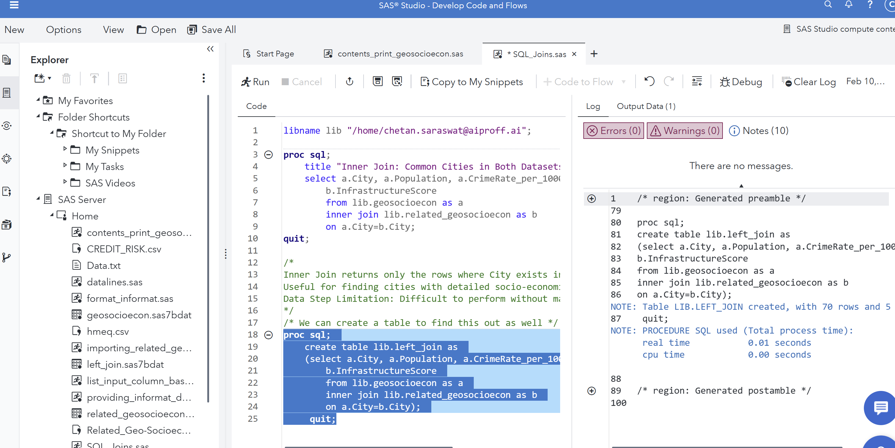
Inner Join – Retrieve common cities in both datasets
We can write the code and select only a part of it to be executed by saying “Run Region”

Slide 200
Inner Join – Retrieve common cities in both datasets
We can write the code and select only a part of it to be executed by saying “Run Region”

Slide 201
Inner Join – Retrieve common cities in both datasets
Once we do that we know a dataset with 70 records has been created .
If we had to achieve the same using Data Step – What would be our approach ?

Slide 202
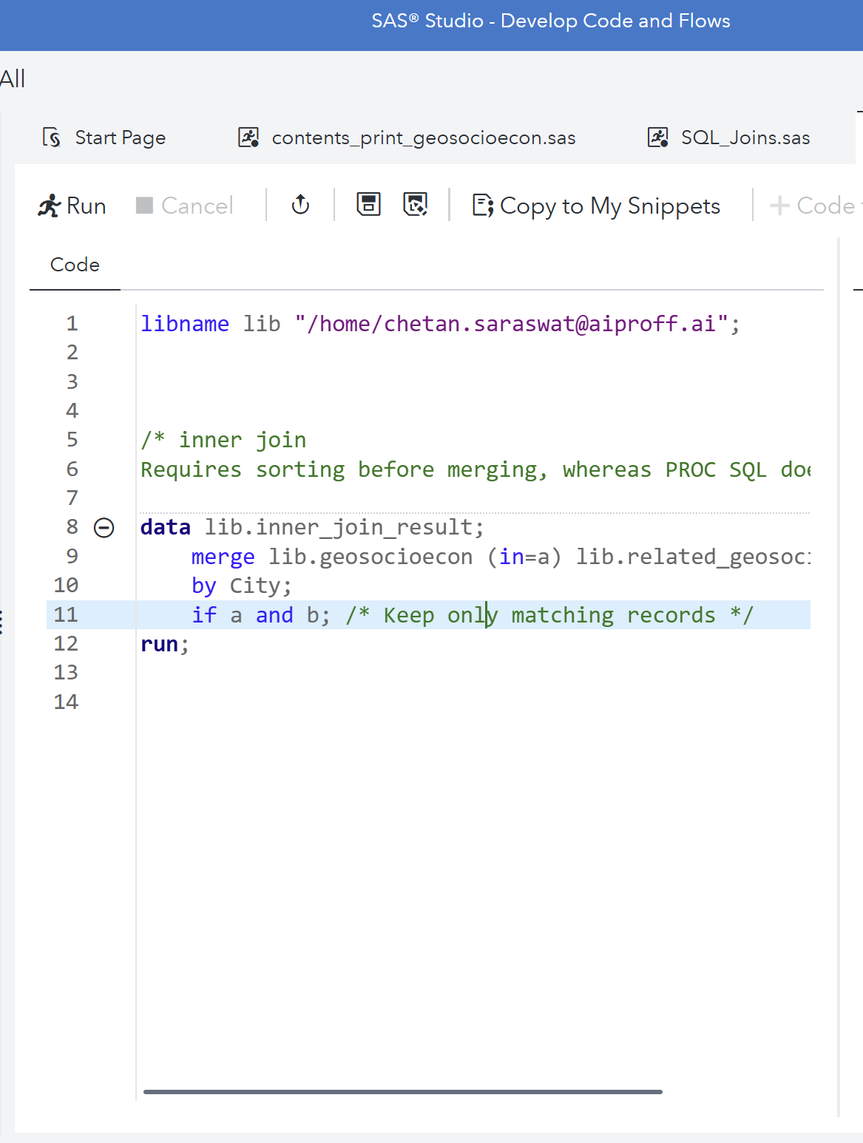
Inner Join Data step equivalent
DATA Step equivalent –
But to do this data sets should be sorted on the
By variable
What will happen if its not ?

Slide 203
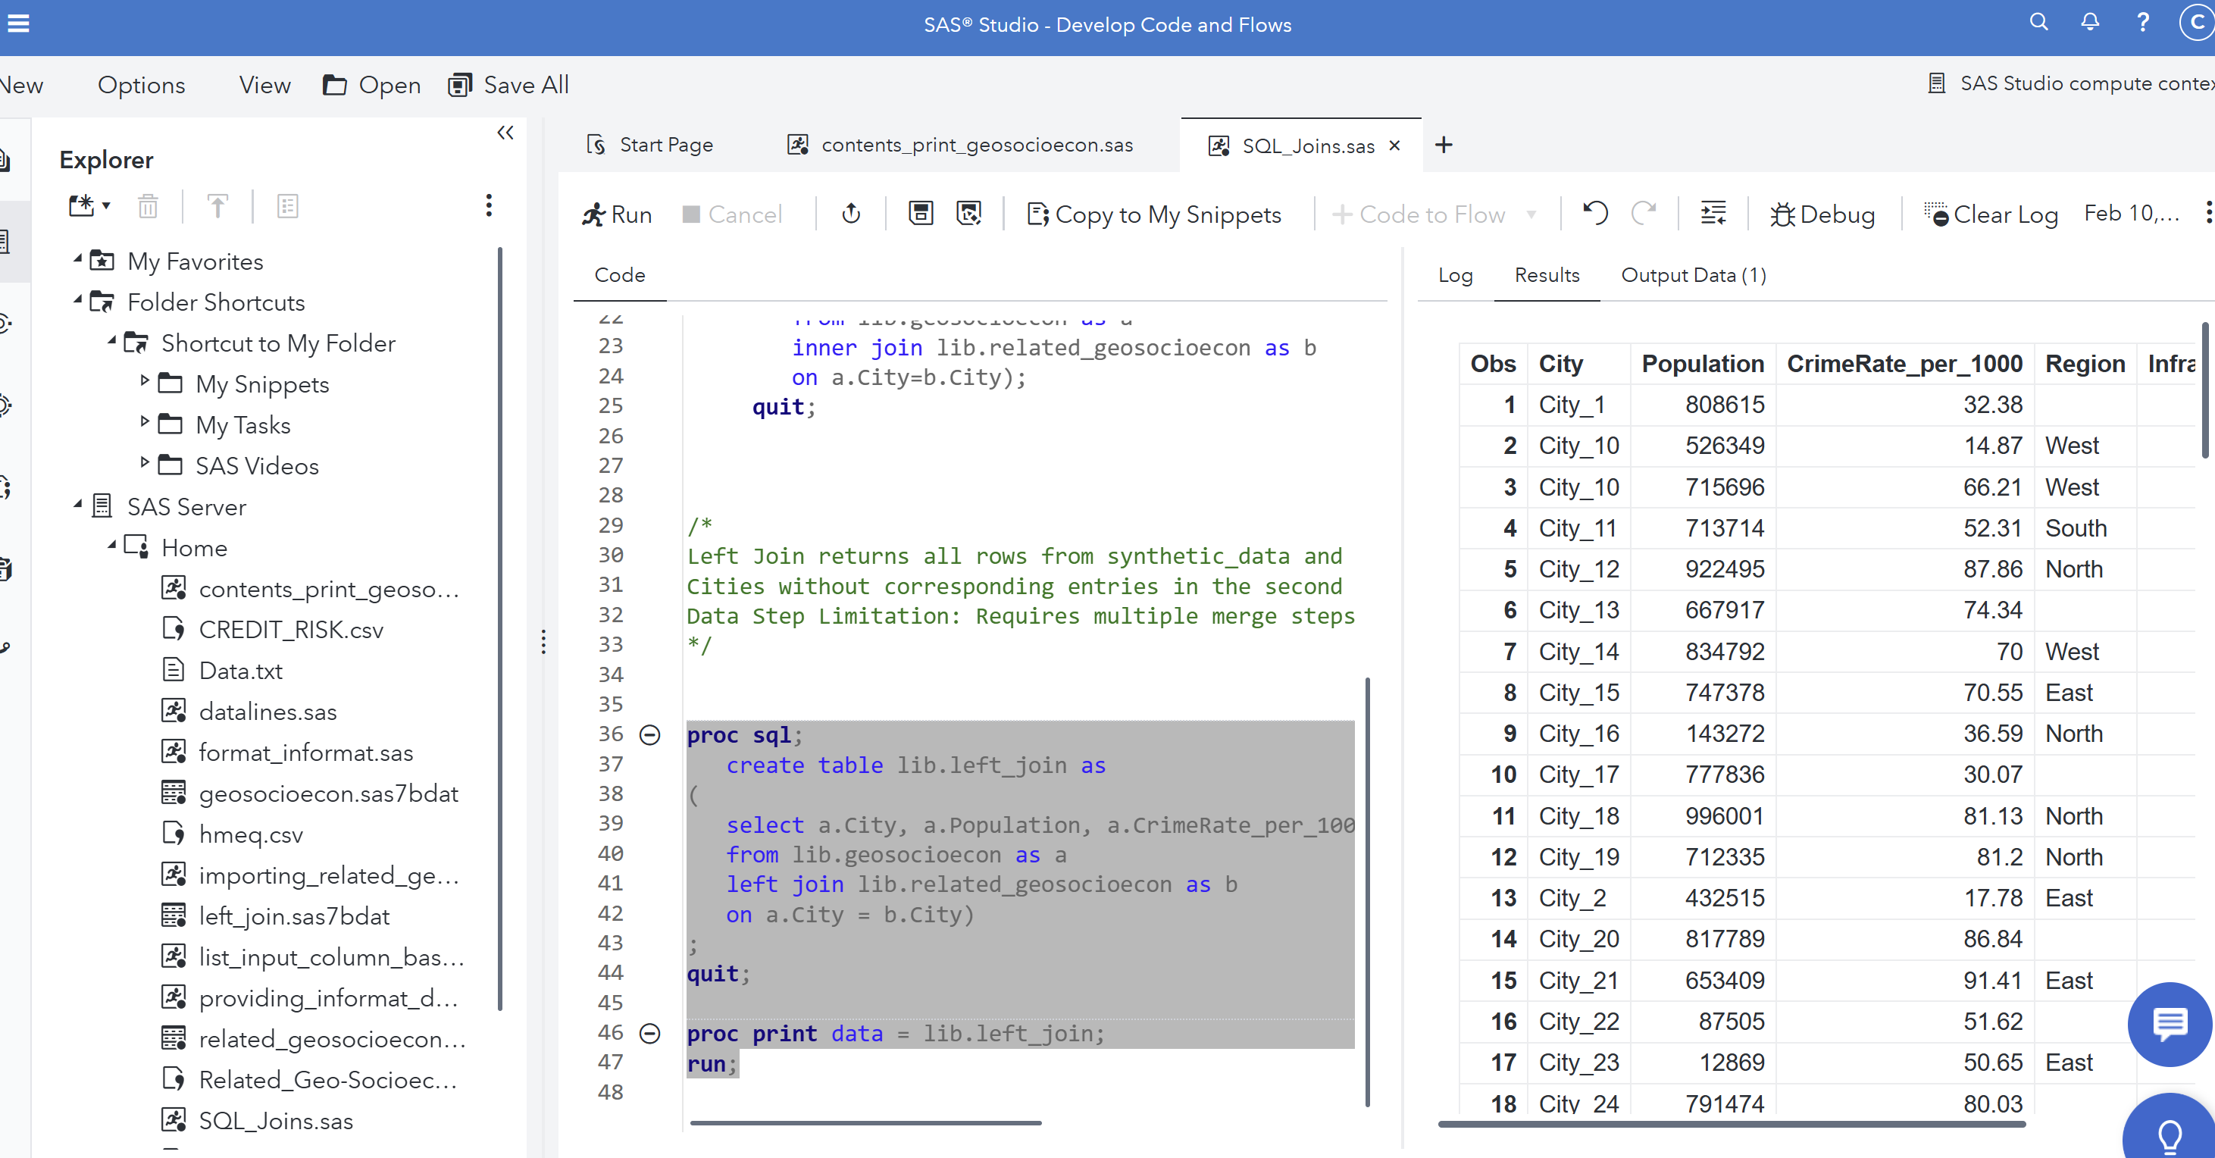
Left Join – Retrieve all cities from the first dataset, with matching values from the second
Left Join returns all rows from synthetic_data and matches values from related_dataset.
Cities without corresponding entries in the second dataset will have missing values (., null).
Data Step Limitation: Requires multiple merge steps and temporary datasets.

Slide 204
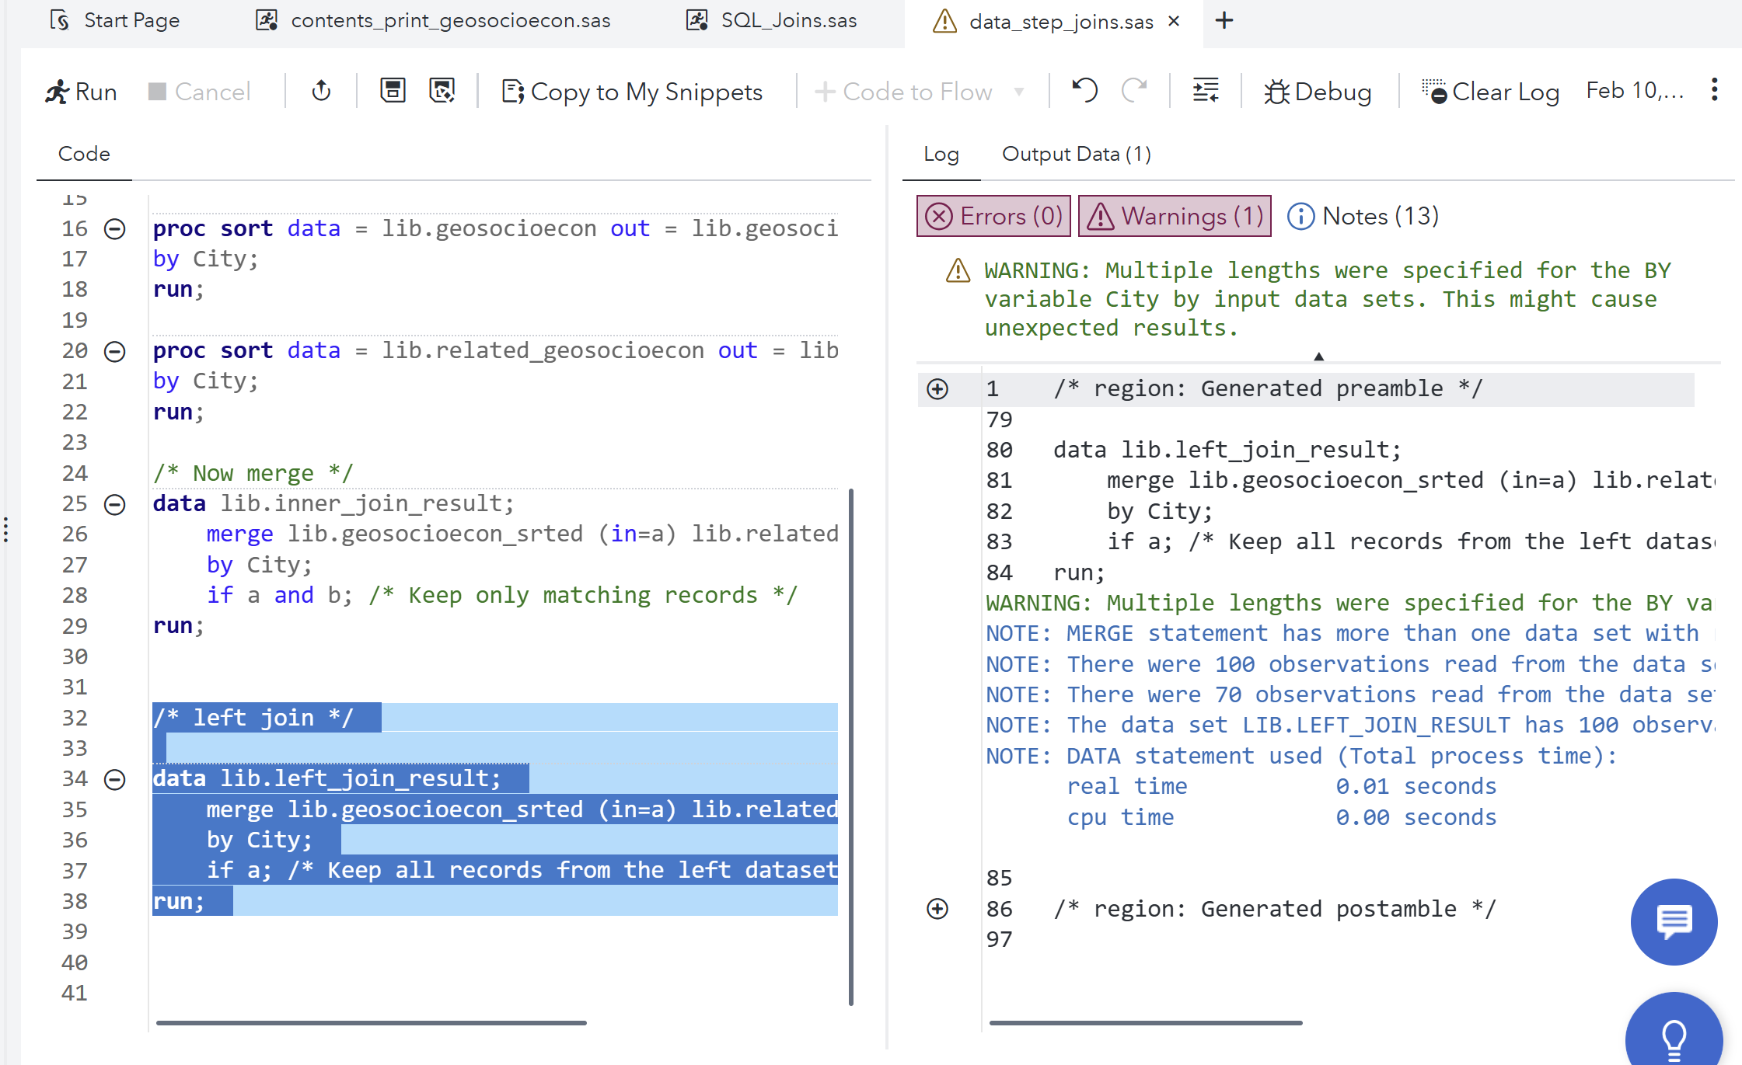
Left Join Data step equivalent

Slide 205
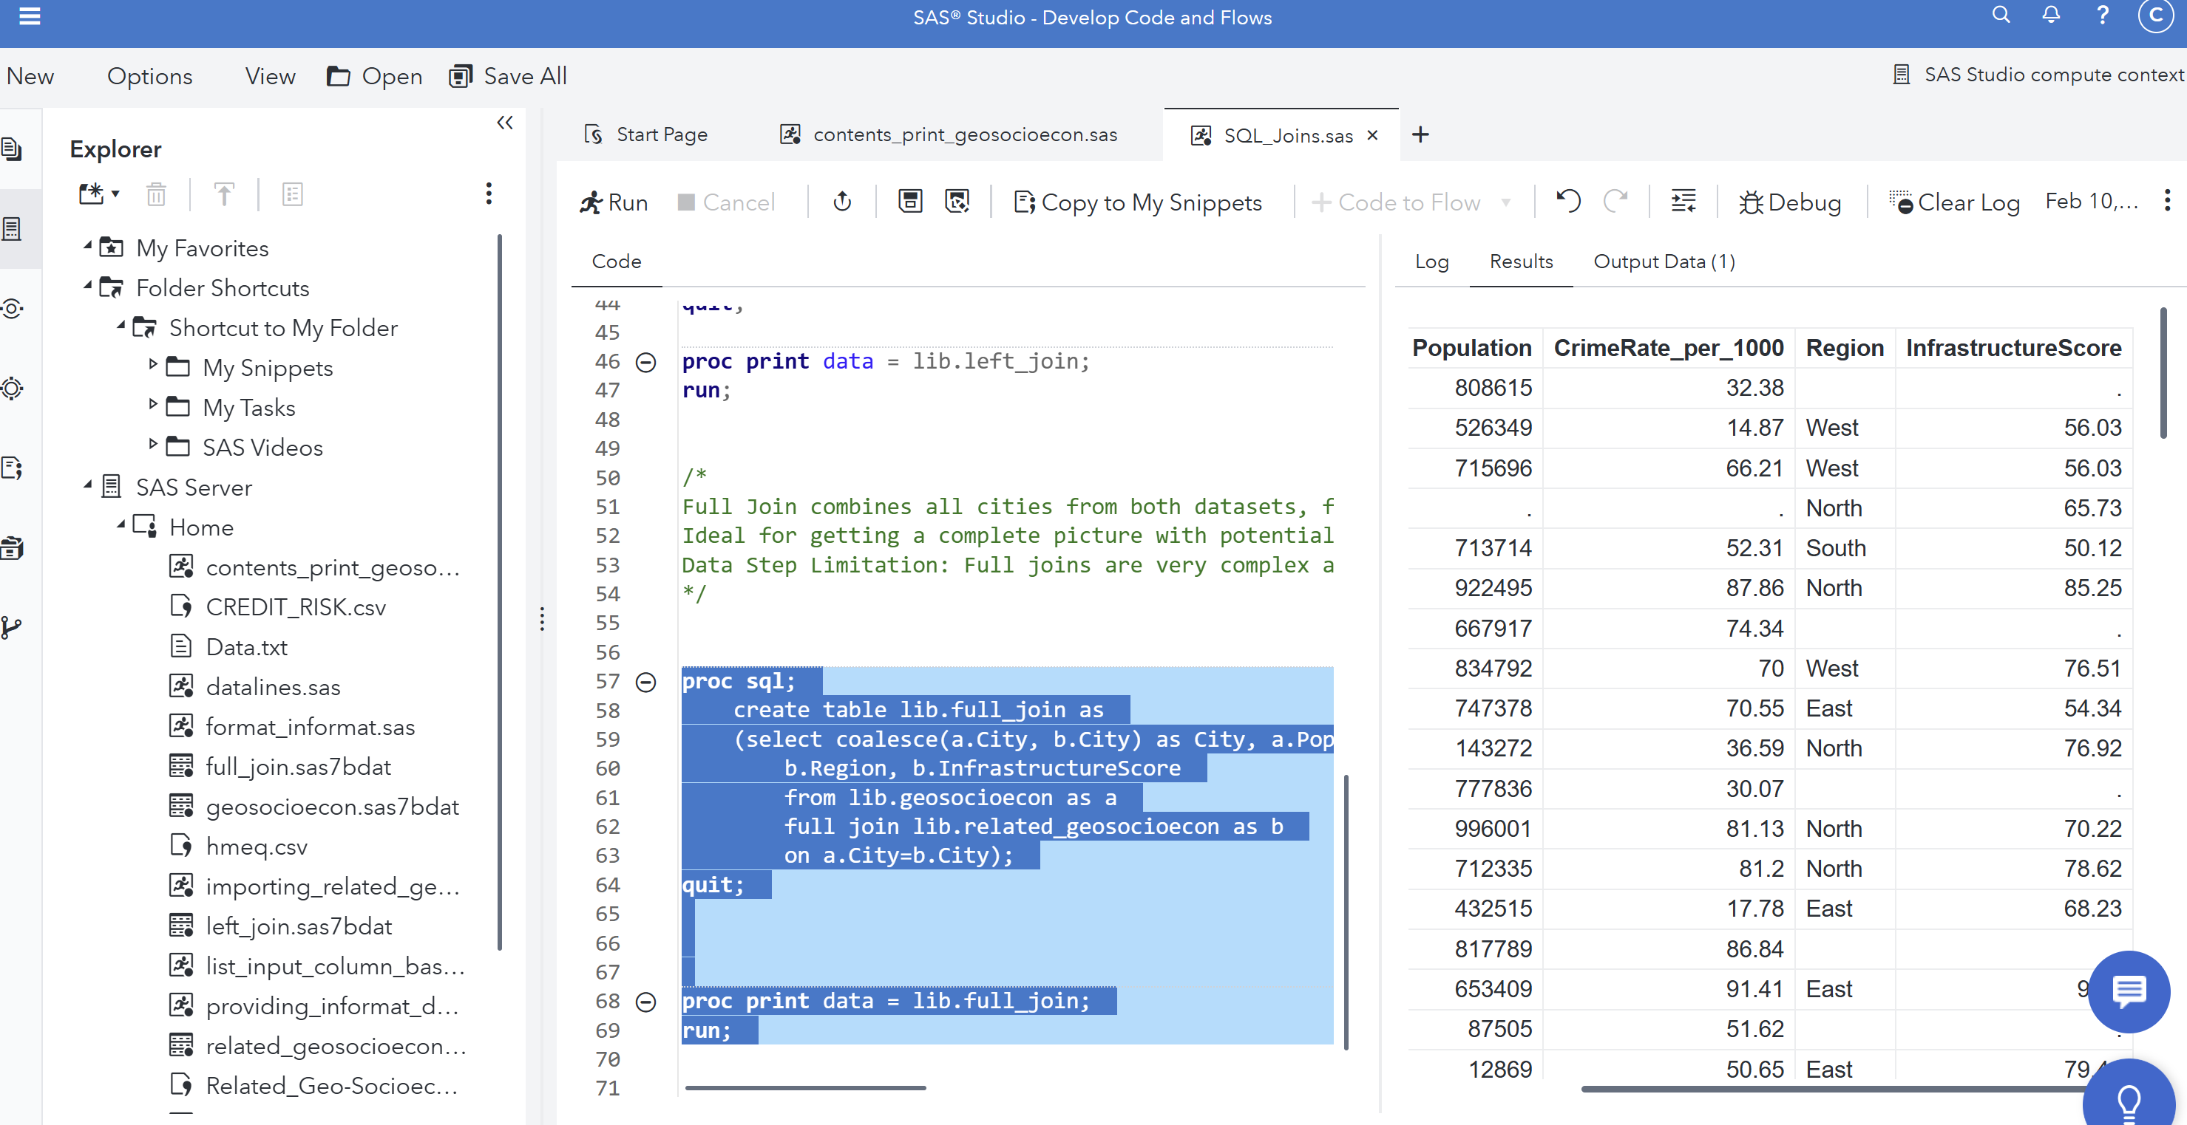
Full Join – Combine all unique cities from both datasets
Full Join combines all cities from both datasets, filling gaps with missing values.
Ideal for getting a complete picture with potential gaps identified.
Data Step Limitation: Full joins are very complex and require multiple merge steps with additional code for handling missing values.

Slide 206
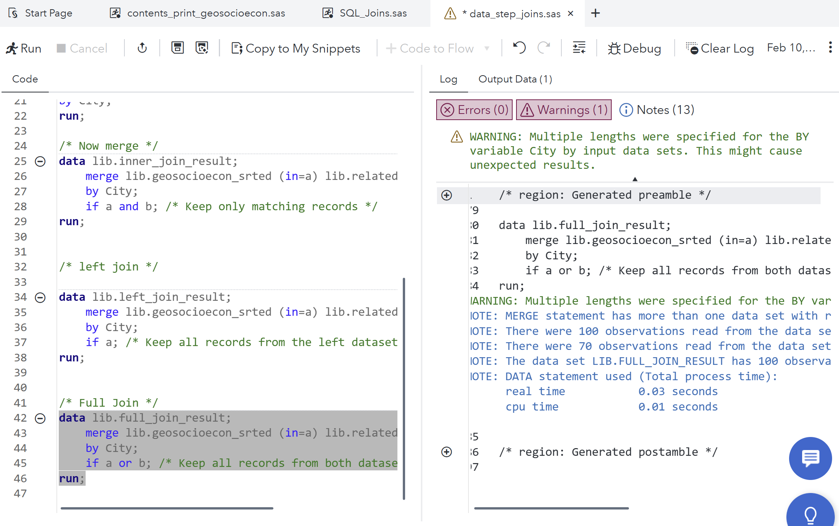
Full Join Data step equivalent

Slide 207
Why PROC SQL is Superior than performing these steps as a Data Steps?
Conciseness and Readability: More compact and readable compared to complex data step merge logic.
Efficiency: Internally optimized for joins, aggregation, and subqueries.
Advanced Conditions: Supports non-equijoin conditions, multiple joins, and inline aggregations (GROUP BY).
Flexible Sorting and Filtering: Inline sorting (ORDER BY) and filtering (WHERE) capabilities.

Slide 208
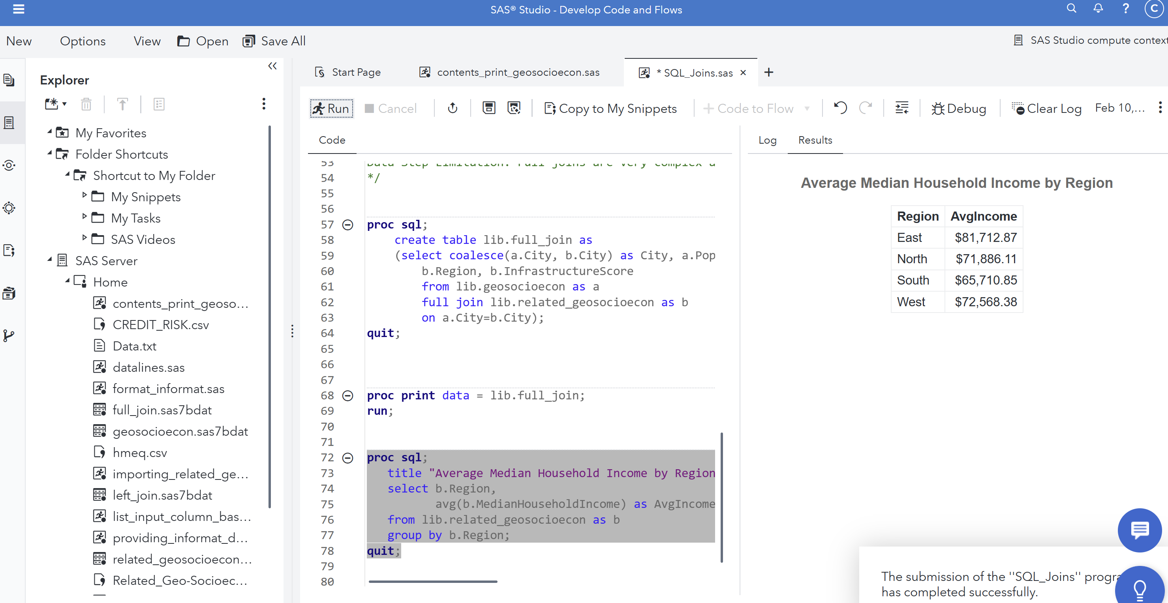
More examples of PROC SQL
Aggregation with GROUP BY – Average income by region
This query calculates the average median household income for each region.
GROUP BY helps to summarize data by regions.

Slide 209
More examples of PROC SQL
DATA Step equivalent -

Slide 210
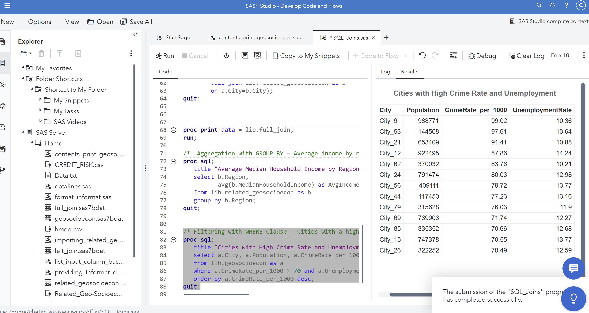
More examples of PROC SQL
Filtering with WHERE Clause – Cities with a high crime rate and unemployment
This query filters cities where the crime rate exceeds 70 and unemployment is above 10%.
ORDER BY sorts the cities by crime rate in descending order.

Slide 211
More examples of PROC SQL
DATA Step equivalent -

Slide 212
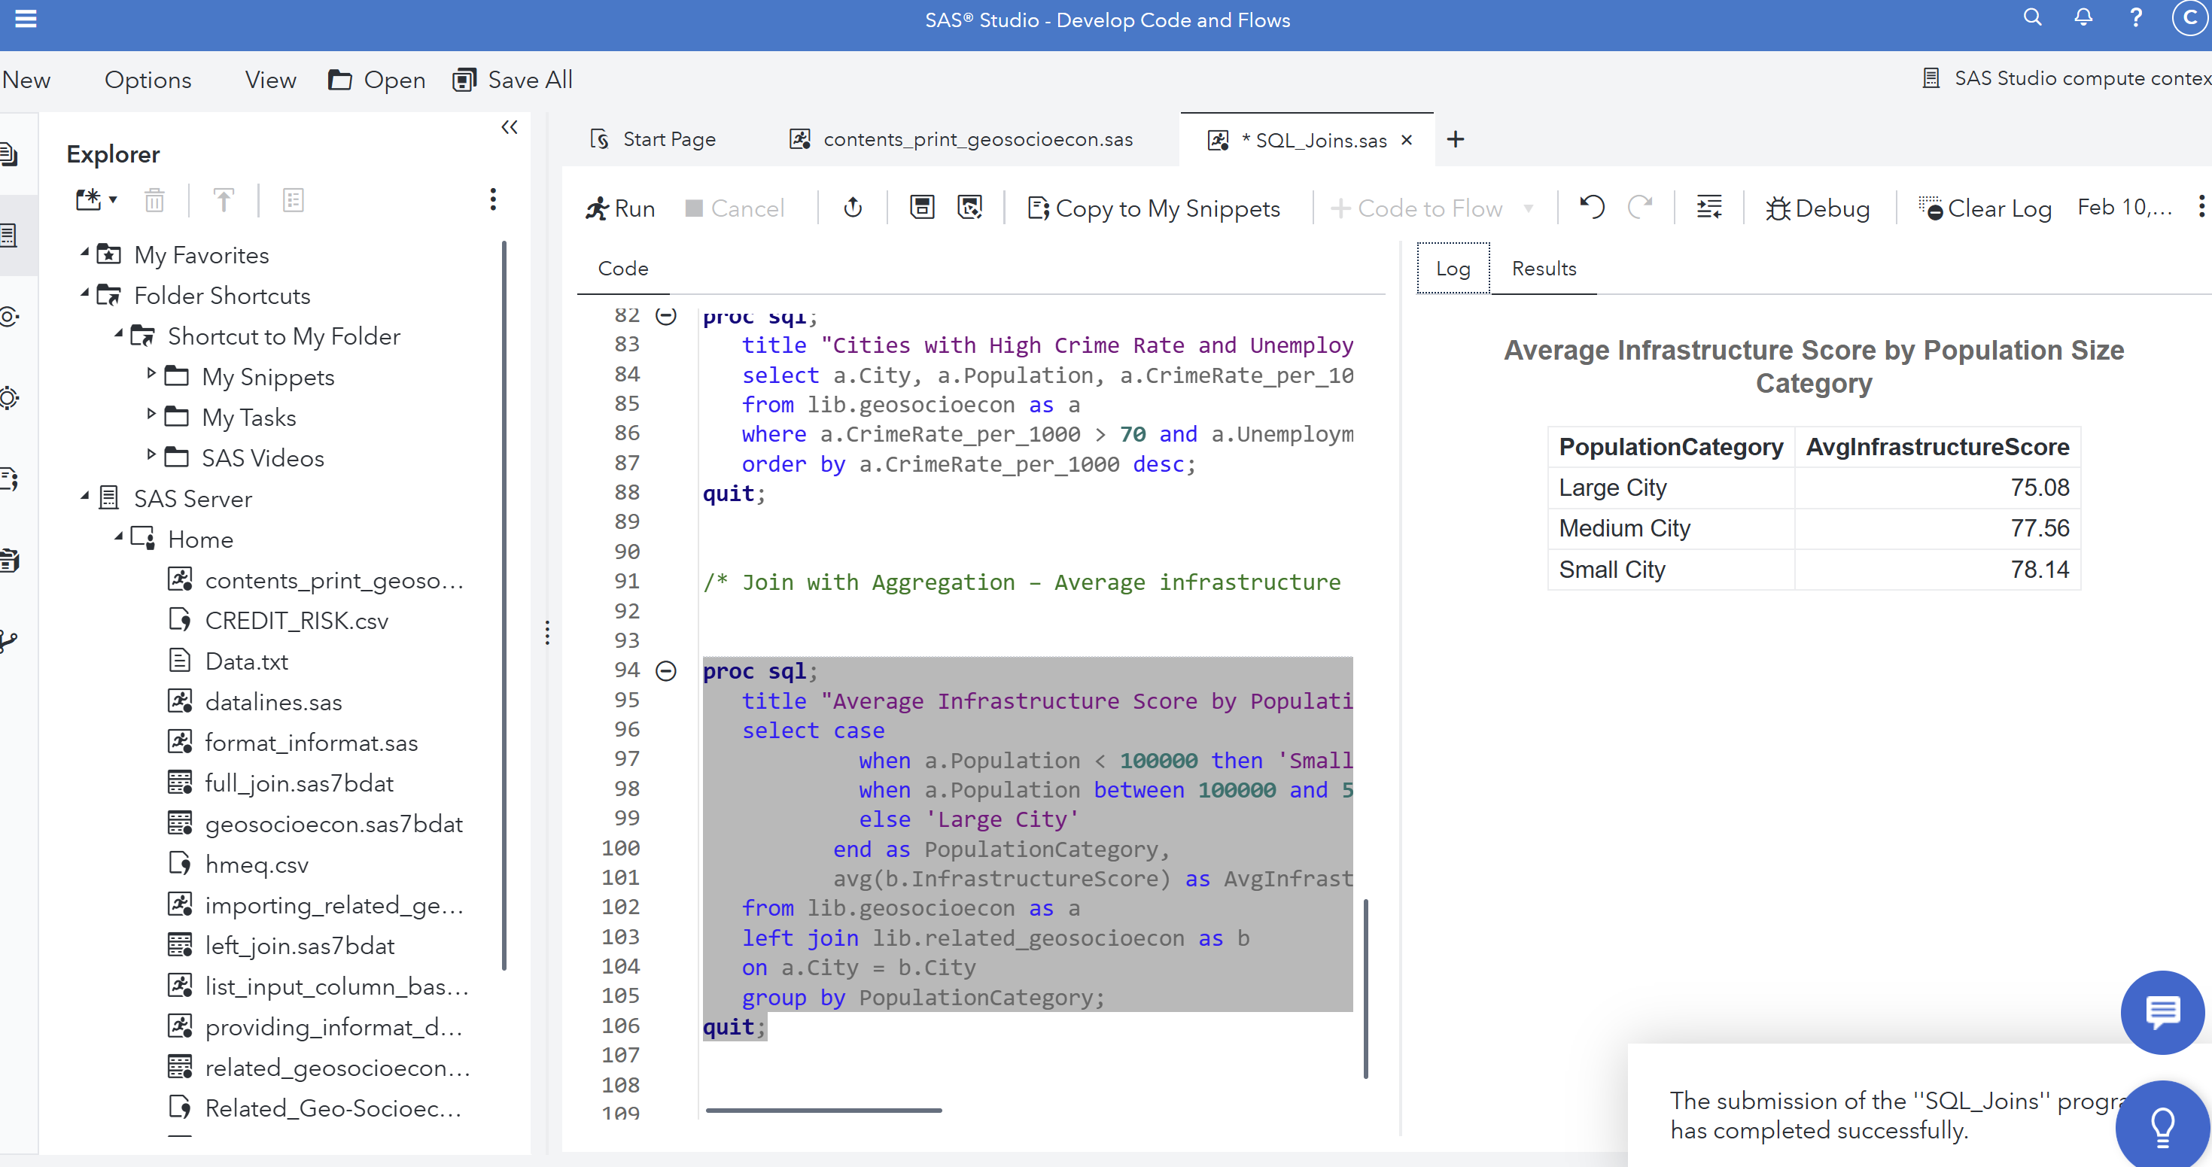
More examples of PROC SQL
Join with Aggregation – Average infrastructure score for cities grouped by population size category
This query categorizes cities based on their population size and calculates the average infrastructure score for each category.
CASE WHEN enables dynamic grouping within SQL.

Slide 213
More examples of PROC SQL
DATA Step equivalent -

Slide 214
CREATING CUSTOM REPORTS
AND EXPORTING DATA

Slide 215
PROCEDURES
SORT procedure:
The general form of the simple PROC SORT step is
PROC SORT DATA=SAS-data-set OUT=SAS-data-set; BY BY-variable(s); RUN;
where
the DATA= option names the data set to be read
the OUT= option creates an output data set containing the data in sorted order.
BY-variable(s) in the required BY statement specifies one or more variables whose values are used to order the data

Slide 216
PROCEDURES
Example of the simple SORT procedure
proc sort data=clinic.admit out=wgtadmit;
by weight;
run;
In the above example the dataset wgtadmit is sorted by the weight of the patient.
The listing of this dataset
generates the following
report.
proc print data=wgtadmit;
run;
Obs | Age | Weight | Fee | Pulse
1 | 24 | 160 | 400 | HIGH
2 | 21 | 164 | 200 | HIGH
3 | 45 | 180 | 100 | LOW
4 | 22 | 191 | 300 | HIGH

Slide 217
PROCEDURES
By default the report displays observations in ascending order of the first BY variable.
The following example sorts the dataset wgtadmit in the descending order of weight and generates the listing of the dataset.
proc sort data = wgtadmit;
by descending weight;
run;
proc print data=wgtadmit;
run;
Obs | Age | Weight | Fee | Pulse
1 | 22 | 191 | 300 | HIGH
2 | 45 | 180 | 100 | LOW
3 | 21 | 164 | 200 | HIGH
4 | 24 | 160 | 400 | HIGH

Slide 218
PROCEDURES
General form of the PRINT Procedure:
PROC PRINT <DATA=SAS-data-set>; RUN;
where SAS-data-set is the name of the SAS data set to be printed.
Note the following points for the default report generated by the PRINT procedure:
all observations and variables in the data set are printed
a column for observation numbers appears on the far left
variables appear in the order that they occur in the data set

Slide 219
PROCEDURES
Example of the PRINT procedure:
libname clinic 'your-SAS-library';
proc print data=clinic.admit;
run;
Obs | Age | Height | Weight | Fee
1 | 27 | 72 | 168 | 100
2 | 34 | 66 | 152 | 200
3 | 31 | 61 | 123 | 300
4 | 43 | 63 | 137 | 100
5 | 51 | 71 | 158 | 150

Slide 220
PROCEDURES
The options used with the PRINT procedure
Customizing the OBS column header.
Specify the OBS= option in the PROC PRINT statement.
Example:
proc print data=clinic.admit obs=‘Patient’;
run;
Removing the OBS column.
Specify the NOOBS option in the PROC PRINT statement.
Example:
proc print data=clinic.admit noobs;
run;

Slide 221
PROCEDURES
Removing the OBS column.
Specify the NOOBS option in the PROC PRINT statement.
Example:
proc print data=clinic.admit noobs;
run;
Controlling the order of the variables and the number of variables to be listed in the report using the VAR statement.
General form of the VAR statement:
VAR variable(s);
where variable(s) is one or more variable names, separated by blanks.

Slide 222
PROCEDURES
Example of the VAR statement:
proc print data=clinic.admit;
var age weight height;
run;
Controlling the observations to be printed by adding the WHERE statement to the PROC PRINT step.
General form of WHERE statement:
WHERE where-expression;
where where-expression specifies a condition for selecting observations.

Slide 223
PROCEDURES
Example of the where statement:
proc print data=clinic.admit;
var age weight height;
where age >30;
run;
Examples of compounded where statement:
where (age<=31 and fee>200) or height > 61;
where pulse in ('LOW',‘HIGH');
where pulse ='LOW' or pulse = HIGH';
where fee in (150,300);

Slide 224
PROCEDURES
Generating column totals for numeric variables to be summed in a SUM statement in the PROC PRINT step.
Example:
proc print data=clinic.admit;
var age height weight fee;
where age > 30;
sum fee;
run;
Column totals appear at the end of the report in the
same format as the values of the variables.
Obs | Age | Height | Weight | Fee
1 | 27 | 72 | 168 | 100
2 | 34 | 66 | 152 | 200
3 | 31 | 61 | 123 | 300
4 | 43 | 63 | 137 | 100
 |  |  |  | 700

Slide 225
PROCEDURES
To display the report generated by PRINT procedure with more descriptive text we use the Label statement as well as the Label Option.For example:
proc print data=clinic.admit label;
label Weight='Weight/Lb ';
run;
Labels can be up to 256 characters long and must be enclosed in quotes
Obs | Age | Height | Weight/Lb | Fee
1 | 27 | 72 | 168 | 100
2 | 34 | 66 | 152 | 200
3 | 31 | 61 | 123 | 300
4 | 43 | 63 | 137 | 100

Slide 226
PROCEDURES
Using the SPLIT= option with the PRINT procedure to enhance the output.
proc print data=clinic.admit split='*’ ;
label Weight='Weight*Lb ';
run;
Obs | Age | Height | Weight Lb | Fee
1 | 27 | 72 | 168 | 100
2 | 34 | 66 | 152 | 200
3 | 31 | 61 | 123 | 300
4 | 43 | 63 | 137 | 100

Slide 227
PROCEDURES
Using the ID statement with the PRINT procedure to identify observations by using the formatted values of the variables that you list instead of by using observation numbers.
proc print data=clinic.admit split='*’ ;
label Weight='Weight*Lb ';
Id fee ;
run;
Fee | Age | Height | Weight Lb | Fee
100 | 27 | 72 | 168 | 100
200 | 34 | 66 | 152 | 200
300 | 31 | 61 | 123 | 300
100 | 43 | 63 | 137 | 100

Slide 228
PROCEDURES
Using the PAGEBY statement to control page ejects that occur before a page is full.
The general form of the PAGEBY statement is :
PAGEBY BY-variable;
where
BY-variable identifies a variable appearing in the BY statement in the PROC PRINT step. If the value of the BY variable changes, or if the value of any BY variable that precedes it in the BY statement changes, PROC PRINT begins printing a new page.

Slide 229
PROCEDURES
Using the SUMBY statement to limits the number of sums that appear in the report.
The general form of the SUMBY statement is :
SUMBY BY-variable;
where
BY-variable identifies a variable that appears in the BY statement in the PROC PRINT step. If the value of the BY variable changes, or if the value of any BY variable that precedes it in the BY statement changes, PROC PRINT prints the sums of all variables listed in the SUM statement.

Slide 230
PROCEDURES
The FREQ procedure is a descriptive as well as a statistical procedure that produces one-way to n-way frequency and cross tabulation tables. It can also compute measures of association and of agreement, and organize output by stratification of the variables.
General form of the basic FREQ procedure
PROC FREQ <DATA=SAS-data-set>; RUN;
where SAS-data-set names the data set to be used.
By default, PROC FREQ creates a one-way table with the frequency, percent, cumulative frequency, and cumulative percent of every value of all variables in a data set.

Slide 231
PROCEDURES
Frequency gives the number of observations with the value.
Percent gives the frequency of the value divided by the total number of observations.
Cumulative frequency gives the sum of the frequency counts of the value and all other values listed above it in the table.
Cumulative percent gives the Cumulative frequency of the value divided by the total number of observations.
ItemName | Frequency | Percent | Cumulative Frequency | Cumulative Percent
Bolt | 2930 | 34.52 | 2930 | 34.52
Locknut | 3106 | 36.60 | 6036 | 71.12
Washer | 2451 | 28.88 | 8487 | 100.00

Slide 232
PROCEDURES
The FREQ procedure creates frequency tables for every variable in your data set by default.
Frequency distributions work best with variables that contain repeating values.
We use the TABLES statement to specify the variables in the FREQ procedure.
The general form of the TABLES statement is
TABLES variable(s);
where variable(s) lists the variables to include.

Slide 233
PROCEDURES
Consider the following DATA step. The dataset created by this DATA step will be used for running the various PROC FREQ examples.
data temp;
input age height weight sex $;
datalines;
65 72 160 F
66 76 152 F
90 56 123 M
90 66 137 F
87 90 144 F
;

Slide 234
PROCEDURES
Consider the following example:
Proc Freq data = temp;
Tables sex age;
run;
Obs | Age | Height | Weight | Sex
1 | 65 | 72 | 160 | F
2 | 66 | 76 | 152 | F
3 | 90 | 56 | 123 | M
4 | 90 | 66 | 137 | F
5 | 87 | 90 | 144 | F
Sex | Frequency | Percent | Cumulative Frequency | Cumulative Percent
F | 4 | 80.00 | 4 | 80.00
M | 1 | 20.00 | 5 | 100.00

Slide 235
PROCEDURES
Age | Frequency | Percent | Cumulative Frequency | Cumulative Percent
65 | 1 | 20.00 | 1 | 20.00
66 | 1 | 20.00 | 2 | 40.00
87 | 1 | 20.00 | 3 | 60.00
90 | 2 | 40.00 | 5 | 100.00

Slide 236
PROCEDURES
By default FREQ procedure displays frequency distributions in the order of each variable’s unformatted values. To control the order in which the FREQ procedure creates the distribution you specify the ORDER = Option.
The general form of the ORDER= option is as follows:
ORDER=DATA|FORMATTED|FREQ|INTERNAL
where
DATA orders values by appearance in the data set
FORMATTED orders by formatted value
FREQ orders values by descending frequency count
INTERNAL orders by unformatted value (default).
ORDER= option does not apply to missing values, which are always ordered first.

Slide 237
PROCEDURES
Example of FREQ procedure with ORDER = formatted;
data temp;
input age height weight sex $;
datalines;
65 72 160 F
66 76 152 F
90 56 123 M
90 66 137 F
87 90 144 F
;
proc format;
value agfmt low-65 ='Average'
66 -87 ='Old'
88 -95 ='Very Old';
Obs | Age | Height | Weight | Sex
1 | 65 | 72 | 160 | F
2 | 66 | 76 | 152 | F
3 | 90 | 56 | 123 | M
4 | 90 | 66 | 137 | F
5 | 87 | 90 | 144 | F

Slide 238
PROCEDURES
→ Continued
proc freq data = temp order = formatted;
tables age;
format age agfmt.;
run;
Age | Frequency | Percent | Cumulative Frequency | Cumulative Percent
AVERAGE | 1 | 20.00 | 1 | 20.00
OLD | 2 | 40.00 | 3 | 60.00
VERY OLD | 2 | 40.00 | 5 | 100.00

Slide 239
PROCEDURES
For a frequency analysis of more than two variables, use PROC FREQ to create n-way crosstabulations. A series of two-way tables will result, with a table for each level of the other variables.
Proc Freq data = temp;
Tables sex*height*weight;
run;
The order of the variables is important. In n-way tables, the last two variables of the TABLES statement become the two-way rows and columns. Variables preceding the last two in the TABLES statement stratify the crosstabulation tables.

Slide 240
PROCEDURES
To generate list output for crosstabulations, add a slash (/) and the LIST option to the TABLES statement in your PROC FREQ step.
TABLES variable-1*variable-2 <* ... variable-n> / LIST;
Proc Freq data = temp;
Tables sex*height*weight/ LIST;
run;

Slide 241
PROCEDURES
You can use options to suppress any of these statistics. To control the depth of crosstabulation results, add any combination of the following options to the TABLES statement:
NOFREQ suppresses cell frequencies
NOPERCENT suppresses cell percentages
NOROW supresses row percentages
NOCOL suppresses column percentages
Proc Freq data = temp;
Tables sex*height*weight/ NOFREQ;
run;

Slide 242
PROCEDURES
PROC MEANS
In its simplest form, PROC MEANS prints the n-count (number of non-missing values), mean, standard deviation, and minimum and maximum values of every numeric variable in a data set.
General form of PROC MEANS:
PROC MEANS <DATA=SAS-data-set>
<statistic-keyword(s)> <option(s)>;
RUN;
where
SAS-data-set identifies the data set to process
statistic-keyword(s) specifies the statistics to compute
option(s) control the content, analysis, and appearance of output.

Slide 243
PROCEDURES
Mentioned below is a example of a PROC MEANS:
PROC MEANS Data = Temp;
Run;
To limit the statistics computed or to specify a different statistic to be computed include statistic keywords as PROC MEANS Options. When a statistic is specified in the PROC MEANS statement, default statistics are not produced.
PROC MEANS Data = Temp median range;
Run;

Slide 244
PROCEDURES
By default, PROC MEANS output uses the BEST. format. This can result in unnecessary decimal places, making the output hard to read.
To limit decimal places, use the MAXDEC= option in the PROC MEANS statement and set it equal to the preferred length.
PROC MEANS Data = Temp median range MAXDEC = 0;
Run;
By default, the MEANS procedure generates statistics for every numeric variable in a data set.
To specify the variables that PROC MEANS analyzes, add a VAR statement and list the variable names.
PROC MEANS Data = Temp median range MAXDEC = 0;
VAR Height Weight;
Run;

Slide 245
PROCEDURES
To produce separate analyses of grouped observations, add a CLASS statement to the MEANS procedure.
PROC MEANS Data = Temp median range MAXDEC = 0;
VAR Height Weight;
CLASS Age;
Run;
PROC MEANS will not generate statistics for CLASS variables because their values are only used to categorize data. Thus, CLASS variables can be either character or numeric.

Slide 246
PROCEDURES
Like the CLASS statement, the BY statement specifies variables to use for categorizing observations
PROC MEANS Data = Temp median range MAXDEC = 0;
VAR Height Weight;
BY Age;
Run;
The BY statement and the CLASS statement differ in following aspect:
Unlike CLASS processing, BY processing requires that your data already be sorted in the order of the BY variables
BY group results have a layout that is different from that of CLASS group results. The BY statement in the program creates separate table for each BY group whereas a CLASS statement would produce a single large table.

Slide 247
PROCEDURES
In order to output statistics to a new dataset use the OUTPUT Out = option.
PROC MEANS DATA = TEMP noprint;
Output out = mean12 mean =chmean max = chmax min = chmin;
run;

